Slide 1

IMAGE – Karnataka
Initiatives for Married Adolescent Girls’ Empowerment
Annual Review 2019 and
Planning meeting 2020

Slide 2
SEVAK, Belagavi

Slide 3
Three major achievements in the year 2019
Capacity building of ASHAs resulted in effective service delivery in the Project locations. ASHAs have changed their way of approach and work with the EMGs. This will be sustained even after the withdrawal of the project.
A total of 67 EMGs who were trained in skill upgradation and vocational trades earning livelihood sustainably.
Child Protection committees taking the issues of violation of child rights including child marriages in three Gram Panchayats as a result of formation and capacity building.

Slide 4
Three major challenges faced in the year 2019
Postponement of pregnancy and spacing between pregnancies among EMGs. Every attempt of counselling hardly pay any results.
Mobilizing EMGs for continuing education was a great challenge.
EMGs trained in vocational trades, they want to earn income but capital investment and marketing of products become a challenge.

Slide 5
Solutions for challenges faced in the year 2019
Counselling of EMGs, spouses and in-laws and reinforcing the information and knowledge on adversities of pregnancy at earlier age and other advantages of postponement and spacing between the pregnancies.
Counselling and encouraging EMGs, Counselling the spouses and dialogue with in-laws
Avoiding uniform skill training - exploring different trades.Linkage with Govt. sponsored schemes.

Slide 6
Three Innovation experimented in the year 2019
Involvement of local Government and Private Health Institutions in providing health care services to the EMGs and their family members. This proved to be effective, cheaper, scaled up and sustainable….
Cost sharing in skill training in tailoring and house decorative items. No running cost is contributed from the project and rather the EMG share the cost..
Production IEC materials on Health issues and using ASHA workers as Resource Persons of Health training to EMGs

Slide 7
Five highlighted project plan for the year 2020
Strengthening and capacity building of Child rights Clubs in all the 27 schools in the project locations
Strengthening and sensitizing all the 9 CPCs in the project locations to address the issues of child rights
Involvement of Govt. departments such as Education, Health, WCD, DCPU, PRI, Revenue, DLSA in the project implementation.
Capacity building of change makers to sustain the initiated activities to be carried out
Enhancing leadership qualities among the EMGs

Slide 8
Highlight of plan for CCI 2020
Child Participation
Involving EMG club members in Project Monitoring committees in all the three locations
Formation, nurturing and strengthening a Taluk level network of Child Rights Club
Effective functioning of Makkala Gram Sabhas in the project locations. (Training of teachers and GP members in cluster level)
Gender Mainstreaming
Involving EMGs, SHGs and Women representatives of PRI in addressing the issues of child marriage.
Addressing the GBV in the community and in Law enforcing authorities
Targeting Spouses for sensitizing on GBV on EMGs and postponement of pregnancies and spacing between pregnancies
Inclusion of CWD
Priority for CWD for continuing education and providing need based Social Security Services form the Government.
Involvement of the CWD in the Child Rights Clubs.
Addressing the issues of CWD in the local CPCs.

Slide 9
Opportunities and identified products for RM
Opportunities
SEVAK foresees mobilization of CSR Funding to address the education, health and livelihood issues of EMGs - through partnership with India CSR Connect.
Taping resources from SEED division of Dept. of Science and Technology for sustainable Income and livelihood opportunities through intervention of innovative technologies.
Involvement of Nehru Yuva Kendra (NYK) Sanghatan in skill development activities for EMGs
Products identified
Health and nutrition enhancement
Agro based livelihood opportunities - dairying, mushroom, …..
Computer education, garment production, …..

Slide 10
REACH, Bagalkot

Slide 11
Three major achievements in the year 2019
Involvement of EMGs participation varies Activities like Gram sabha, Dist Child Rights Parliament,
32 EMGs Educational services & 160 EMGs trained in our Vocational training.
Our IMAGE Project Team Member Mrs.Sailaja G K Selected DH Changemaker 2020 in Child Rights.

Slide 12
Three major challenges faced in the year 2019
Spouse Meetings are conducted very difficult in the village
Postpone pregnancy is very difficulty to educate to EMGs Spouses
EMG Families Not support to EMGs for Education

Slide 13
Solutions for challenges faced in the year 2019
We are organized the spouse meeting in evening time
2. We are more awareness & counseling giving to their families regarding SRHR and also We are advocacy through news paper to Prevention of pregnancy its reflected KSCPCR Visit the village and Govt deportment done the EMG survey to given the responsibility to the deportment.
3. We tried to convenience EMG families then link to vocational training who not supportive families.

Slide 14
Three Innovation experimented in the year 2019
We are conducted GBV Program at muttalagere with allied deportment like as Police department, Mahila shakthi kendra, SDMC, Gram Panchayath, DCPU, Health department, Labour dept, CDPO office to explore the sensitize the issue.
IMAGE project area 5 Panchayath-children gram sabha organised collaborate with us to identification of EMG issue raised the children & EMGs.
Jula Wire knitting - Home Decoration Items Exhibition in Deshpande Foundation to explore the EMGs Skill And IMAGE Concept.

Slide 15
Five highlighted project plan for the year 2020
Formation and strengthening the District level children federation
High number of out of the school children re-enrollement
involvement of GP to strengthening the Child Protection committee /Child Rights Protection Committee through child participation.
5 child marriage free village declaration with the community participation.
Govt deportment involve to linkage the schemes to EMGs

Slide 16
Highlight of plan for CCI 2020
Child Participation
Child rights grama sabha initiative through the children clubs.
Our program/activities taking the feedback from the children.
Child marriage issue based minimum 3 children build the as a trainer.
Gender Mainstreaming
GBV trainings/programs to sensitization.
SHG members create the awareness regarding the Gender issue
Film Screening
Inclusion of CWD
CWD Identification and linkages to the concern deportment and service providers.
Image covered area CWD friendly toilet referral to gram panchayath

Slide 17
Opportunities and identified products for RM
Opportunities
Textile deportment have a source pads making funds.
Gram panchayath have a source for free distribution of tailoring machine for SC/STs
Products identified
Home decoration items

Slide 18
PMSR, Kollegal

Slide 19
Three major achievements in the year 2019
11 EMGs have registered to write Public Exam privately
286 EMGs have received skill training (Computer, tailoring, saree designing, door mat making)
Children’s Club members stopped 12 child marriages

Slide 20
Three major challenges faced in the year 2019
Gathering Spouses in villages for Spouse Forum was a challenge
Conducting Child Protection Committees was a challenge
Empowering the Soliga tribal EMGs continues to be a challenge

Slide 21
Solutions for challenges faced in the year 2019
Instead of having Spouse Forum meetings in villages, organized Spouse Forums in Kollegal PMSR Office and Spouses attended the meetings.
Lobbied with Panchayat Officers giving the Government Orders for conducting CPCs and Field Facilitators facilitated in conducting the meetings by personally inviting the members.
Lobbying with Tribal Headman (Podina Nayaka) of each Podu and convincing them to permit EMGs. Contacted Rutseti in Chamrajnagar to provide skill training for tribal EMGS in 2020.

Slide 22
Three Innovation experimented in the year 2019
District level Children’s Club Leaders Meeting
Through involving Child Protection Committees to readmit dropouts as well as stopping child marriages (In Lokkanahalli Panchayat 18 children,in Maduvanahalli Panchayat 2 dropouts)
As there is a great need to outreach pre-adolescent children on issues of child safety, we are training Children’s Club members as well as Parents to teach pre-adolescent children on child safety beginning with good touch and bad touch. We have produced IEC materials for pre-adolescent children as well as parents on this issue.

Slide 23
Five highlighted project plan for the year 2020
SHG formation for EMGs
Leadership & capacity building of SHGs for EMGs
Training of Child Protection Committee members on their roles and responsibilities
Training of SDMC members and VRWs on strengthening their concern for child protection
Vocational skill Training for Soliga EMGs through Rudseti

Slide 24
Highlight of plan for CCI 2020
Child Participation
Involving Children’s Club leaders in Village level/ Panchayat level Child Protection Committees
Involving pre adolescent school going children on Child Safety
Organizing Child Parliament at Block levels and Child Right Gram Sabhas
Gender Mainstreaming
Will include women survivors who had child marriage at the planning stage for 2021 IMAGE programme
Including women (mothers and In Laws of EMGs) in the year end evaluation of IMAGE activities
Strengthening SHG members in child protection and prevention of child marriage
Inclusion of CWD
Giving limb care to orthopedically disabled children.
Community based rehabilitation of CWDs in selected villages
Conducting sports for CWDs and participation in World Disabled Day District Level Sports at Chamrajnagar

Slide 25
Opportunities and identified products for RM
Opportunities
NABARD (Government) grant for women entrepreneurs
Department of Handlooms and Textiles for skill training
Products identified
Power Silk reeling unit
Certificate course for Tailoring course for manual/power machines

Slide 26
Vidyaniketan, Bidar

Slide 27
Three major achievements in the year 2019
48 EMG’s started their own business with the support of R.F.
Through skills trainings 26 EMG’s are working independently and earning Rs. 4000 -5000 per month.
Re-enrolled 18 EMG’s for the formal Education (6 EMG's are 9th continuing; 9 EMG's are 10 the exam appearing & 3 EMG's are Ist PUC regular attending).

Slide 28
Three major challenges faced in the year 2019
95% of spouses are daily labour’s they were not available in day time to form a spouse clubs.
Not good transport facility for community facilitator to visit more villages in a day.
Bring EMG’s to out station training’s and meeting’s.

Slide 29
Solutions for challenges faced in the year 2019
Forming spouse clubs with available spouses.
Managing with local transport facility.
Regular follow-up to the family and counselling individual was made possible to bring EMG’s out station training’s and Meeting’s.

Slide 30
Three Innovation experimented in the year 2019
Meeting with 7 Govt. Headmaster's to enroll EMG’s to formal education.
Installation of skills training centers in EMG’s respective villages helps EMG’s learn more.
Encouraging Change makers by giving honorarium, Gifts and training’s helped to stop 22 child marriage from 23 villages.

Slide 31
Five highlighted project plan for the year 2020
Enrolling 35 EMG’s to formal Education.
Enrolling 125 EMG’s various skill trainings.
Formation of more EMG’s Groups and strengthening them.
Planned stop approximately 45 child marriages through CR,Kishories,EMG’s, and Family Clubs.
Planned to organize more training/awareness program to all religious Leaders to stop child marriage.

Slide 32
Highlight of plan for CCI 2020
Child Participation
Formation of child Rights clubs in govt. Schools strengthening them to participate in vishesha makkala Grama Sabha to demand their basic needs.
Formation of Taluka level children parliament and strengthening them.
Formation Kishories clubs in the community strengthening them on various issues.
Gender Mainstreaming
Involving EMG’s and SHG’s groups in prevention of child marriage
Sensitization of adverse effect of GBV in CR, Kishories, Family clubs.
Referring needy GBV victims to DLSA
Inclusion of CWD
Enrolling more CWD to mainstream Education.
Making available of Government facilities to the CWD
Encouraging CWD to participate in all clubs, and school programs.

Slide 33
Opportunities and identified products for RM
Opportunities
More financial support to EMG’s groups from other financial institution.
Involve survivors in government schemes and skill trainings
Products identified
Certificate course for computer and tailoring centers.
Revolving Fund supports.
Production of schools and Hand bags unit.

Slide 34
ARPANAM Trust, Bagepalli

Slide 35
Three major achievements in the year 2019
Re-enrolled 7 school dropout children at Nallagutlapalli Panchayat and stopped 2 child marriages.
Enrolled 11 EMGs for SSLC and 9 EMGs for PUC examinations.
Placed 97 EMGs in Tailoring course and 3 EMGs in beautician course training, by opening 7 VT Centers in 3 clusters.

Slide 36
Three major challenges faced in the year 2019
We were facing problem to gather spouses at one place for the spouse club meetings.
We struggled a lot to convince the parents of EMGs for taking EMGs out of station from their villages for our programs.
Initially school staff did not allow us to make our wall painting on the school buildings.

Slide 37
Solutions for challenges faced in the year 2019
Regular house visits and awareness on child marriage issues improved the platform of gathering spouses
EMGs’ parents were convinced by visiting their houses a number of times continuously.
We met BEO and Cluster Coordinator and explained them about the importance of our wall paintings and how it will impact on child marriage prevention.

Slide 38
Three Innovation experimented in the year 2019
Decentralised VT Centers in community level.
We conducted Hobli level children club competition programme on issues of child marriage.
Took our EMGs to district level child rights committee meeting conducted by CRT, Siddlagatta and created an opportunity to them to speak out their problems & their feelings on child marriage issue, in front of government officials.

Slide 39
Five highlighted project plan for the year 2020
To encourage and support our EMGs, who have completed skill training to start income generation.
To give financial advisory services to EMGs for improving their savings skills.
To form SHG and strengthen the capacity of SHG members.
To build confidence level among EMGs to speak out their needs and get assistance from government departments.
To involve government school teachers more effectively in our upcoming programmes.

Slide 40
Highlight of plan for CCI 2020
Child Participation
To place suggestion box in schools for dropping their complaints on child marriage.
To bring awareness about child marriage in community, by making school children practice and perform street plays in public.
To make them indulge in village level and cluster level anti-child marriage programmes and create a platform to speak out their feelings on child marriage issue.
Gender Mainstreaming
To strengthen the capacity of EMGs towards prevention of child marriage.
To sensitize on GBV issues in family and kishori clubs.
Inclusion of CWD
To give more preference to CWDs for participation in child rights programmes.
To train staff to refer CWD’s problems to related rehabilitation centers.
To create suitable platform for CWDs to express their feelings and problems in front of government officials, by involving them in our programmes.

Slide 41
Opportunities and identified products for RM
Opportunities
The good rapport between the govt schools has created an opportunity to use school & government buildings or public places for our programmes, instead of taking halls on rent.
Utilise the maximum budget for program implementation and avoid unnecessary expenditure in programme.
To find and mobilise local resources for programmes.
Products identified
To search for government programmes to impart skill training
Getting help from local NGOs already working in the field or willing to work for the welfare of EMGs.

Slide 42

CRT, Bangalore

Slide 43
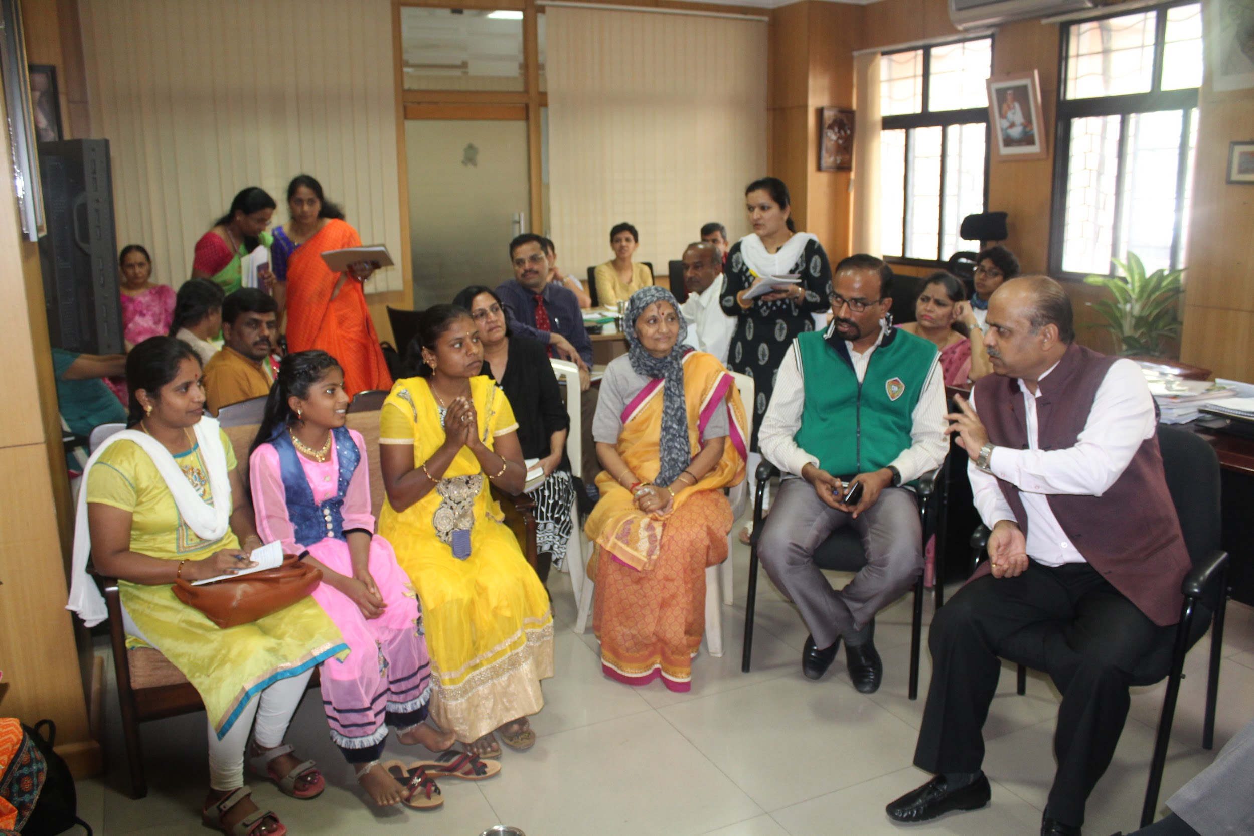
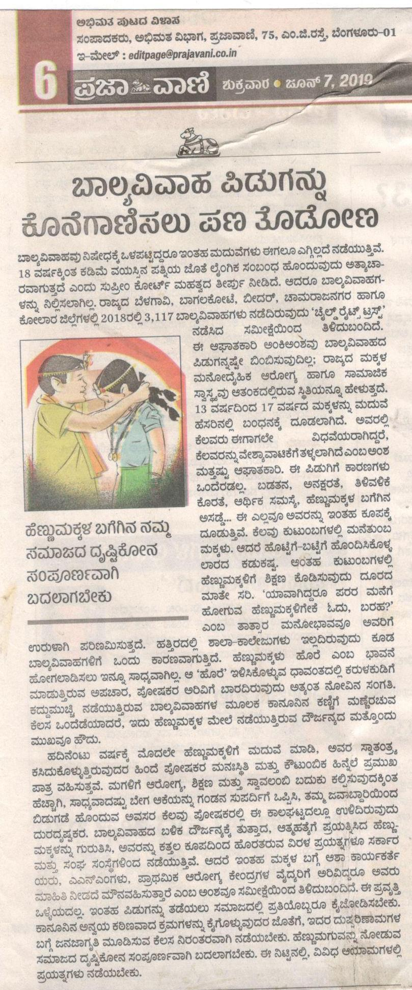
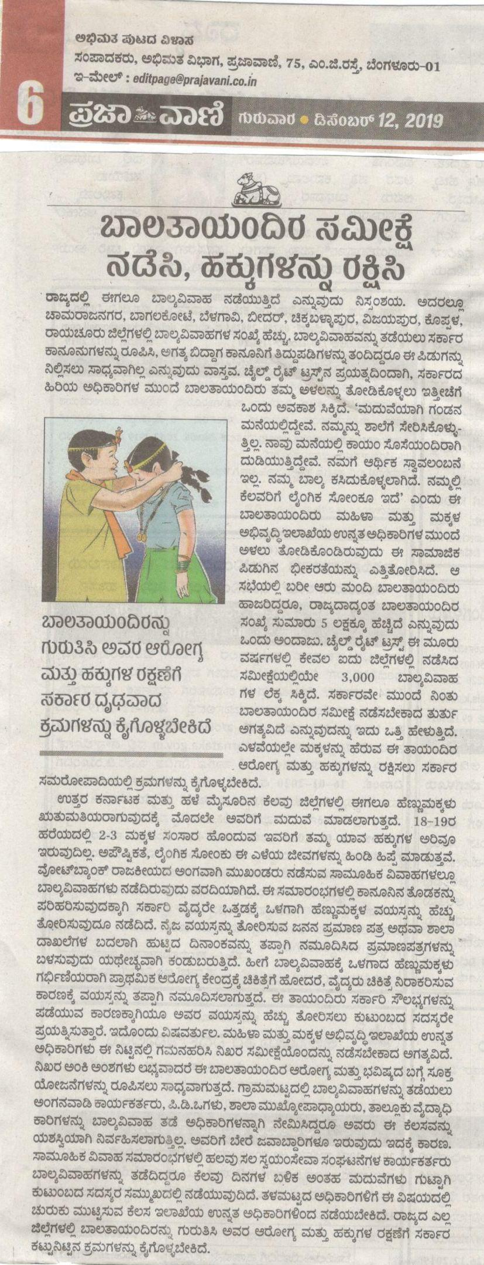
Three major achievements in the year 2019
Advocacy meeting with the Secretary to Govt., DWCD, GoK and the Committee on EMGs with the EMGs on 10th Dec. 2019. First of its kind meeting to bring up the EMGs issues
Convening media visits and coverage on EMGs from various districts (Prajavani, Deccan Herald, TOI, CNN IBN, etc). Prajavani wrote editorials (twice on the same issue in a span of six months)
Member Secretary, Karnataka Legal Services Authority (KLSA) issued an official order to District Legal Service Authorities (DLSA) - Belagavi, Bagalkot, Bidar, Chamarajanagar and Chikkaballapur to support and collaborate with IMAGE project partners.
CRT is part of the resource team on State level orientation on Child Rights Grama Sabhas organised by RDPR (Rural Development and Panchayat Raj Dept, GoK)

Slide 44
Three major challenges faced in the year 2019
Govt delaying in accepting the advocacy asks and responding to the same - e.g., meeting of the Committee on EMGs; providing minutes of the meeting, etc
Frequent transfers of the top level officials in DWCD that affected maintenance of continuity of discussion
By elections in Bengaluru and some other districts posed a threat to several important meetings, resulting in either cancellation or postponement

Slide 45
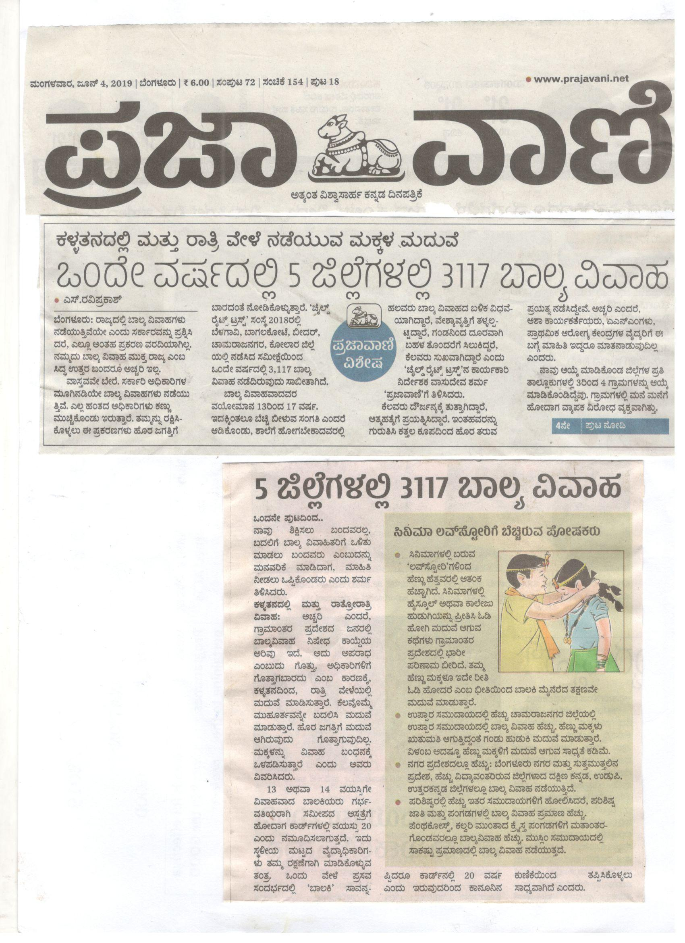
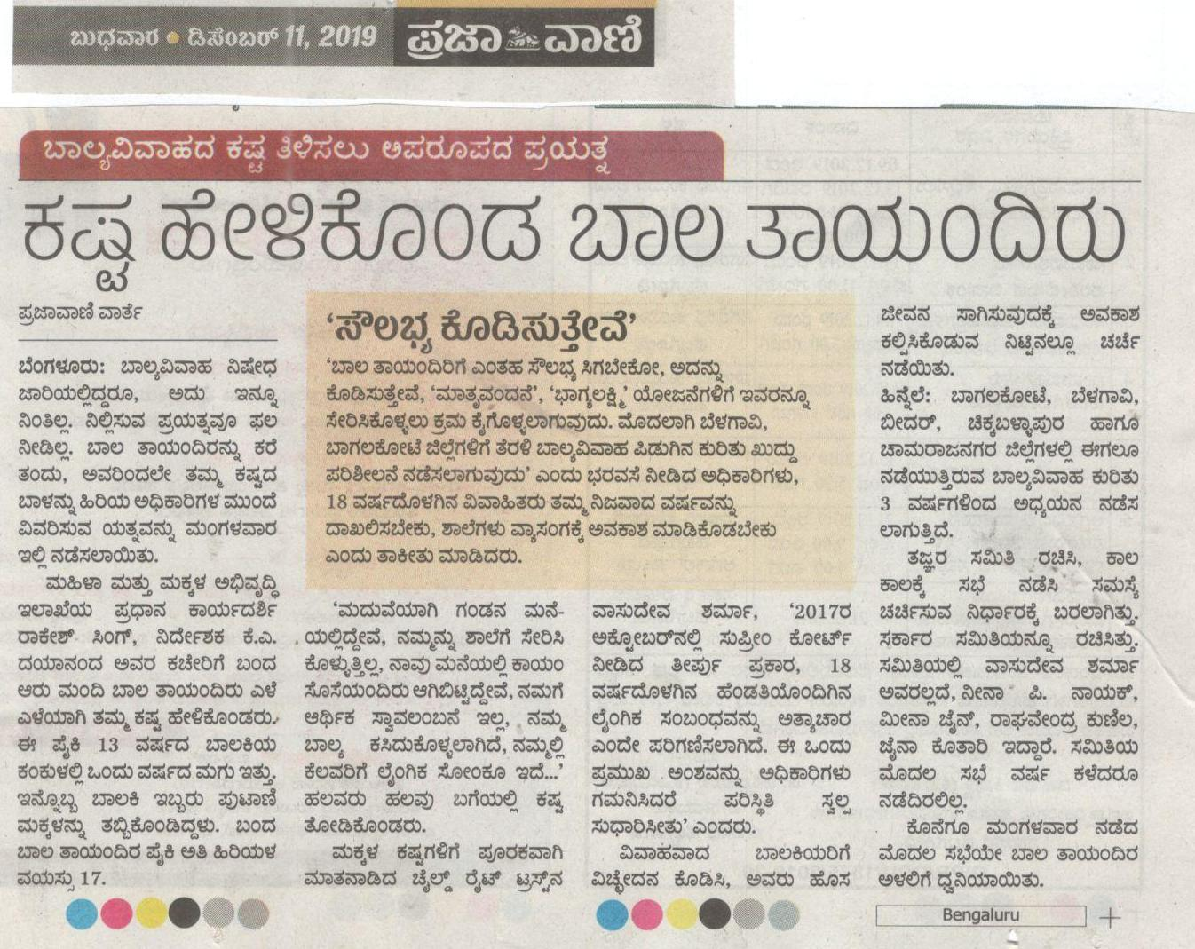
Solutions for challenges faced in the year 2019
Repeated visits to the Govt offices and also convincing the new officials about the issue and the need for attending the same on an urgent basis
Data about the 3077 EMGs in hand a great evidence to convince the Govt officials and the media
Higher authority letter helps IMAGE project partners to have Good collaboration with district officials

Slide 46
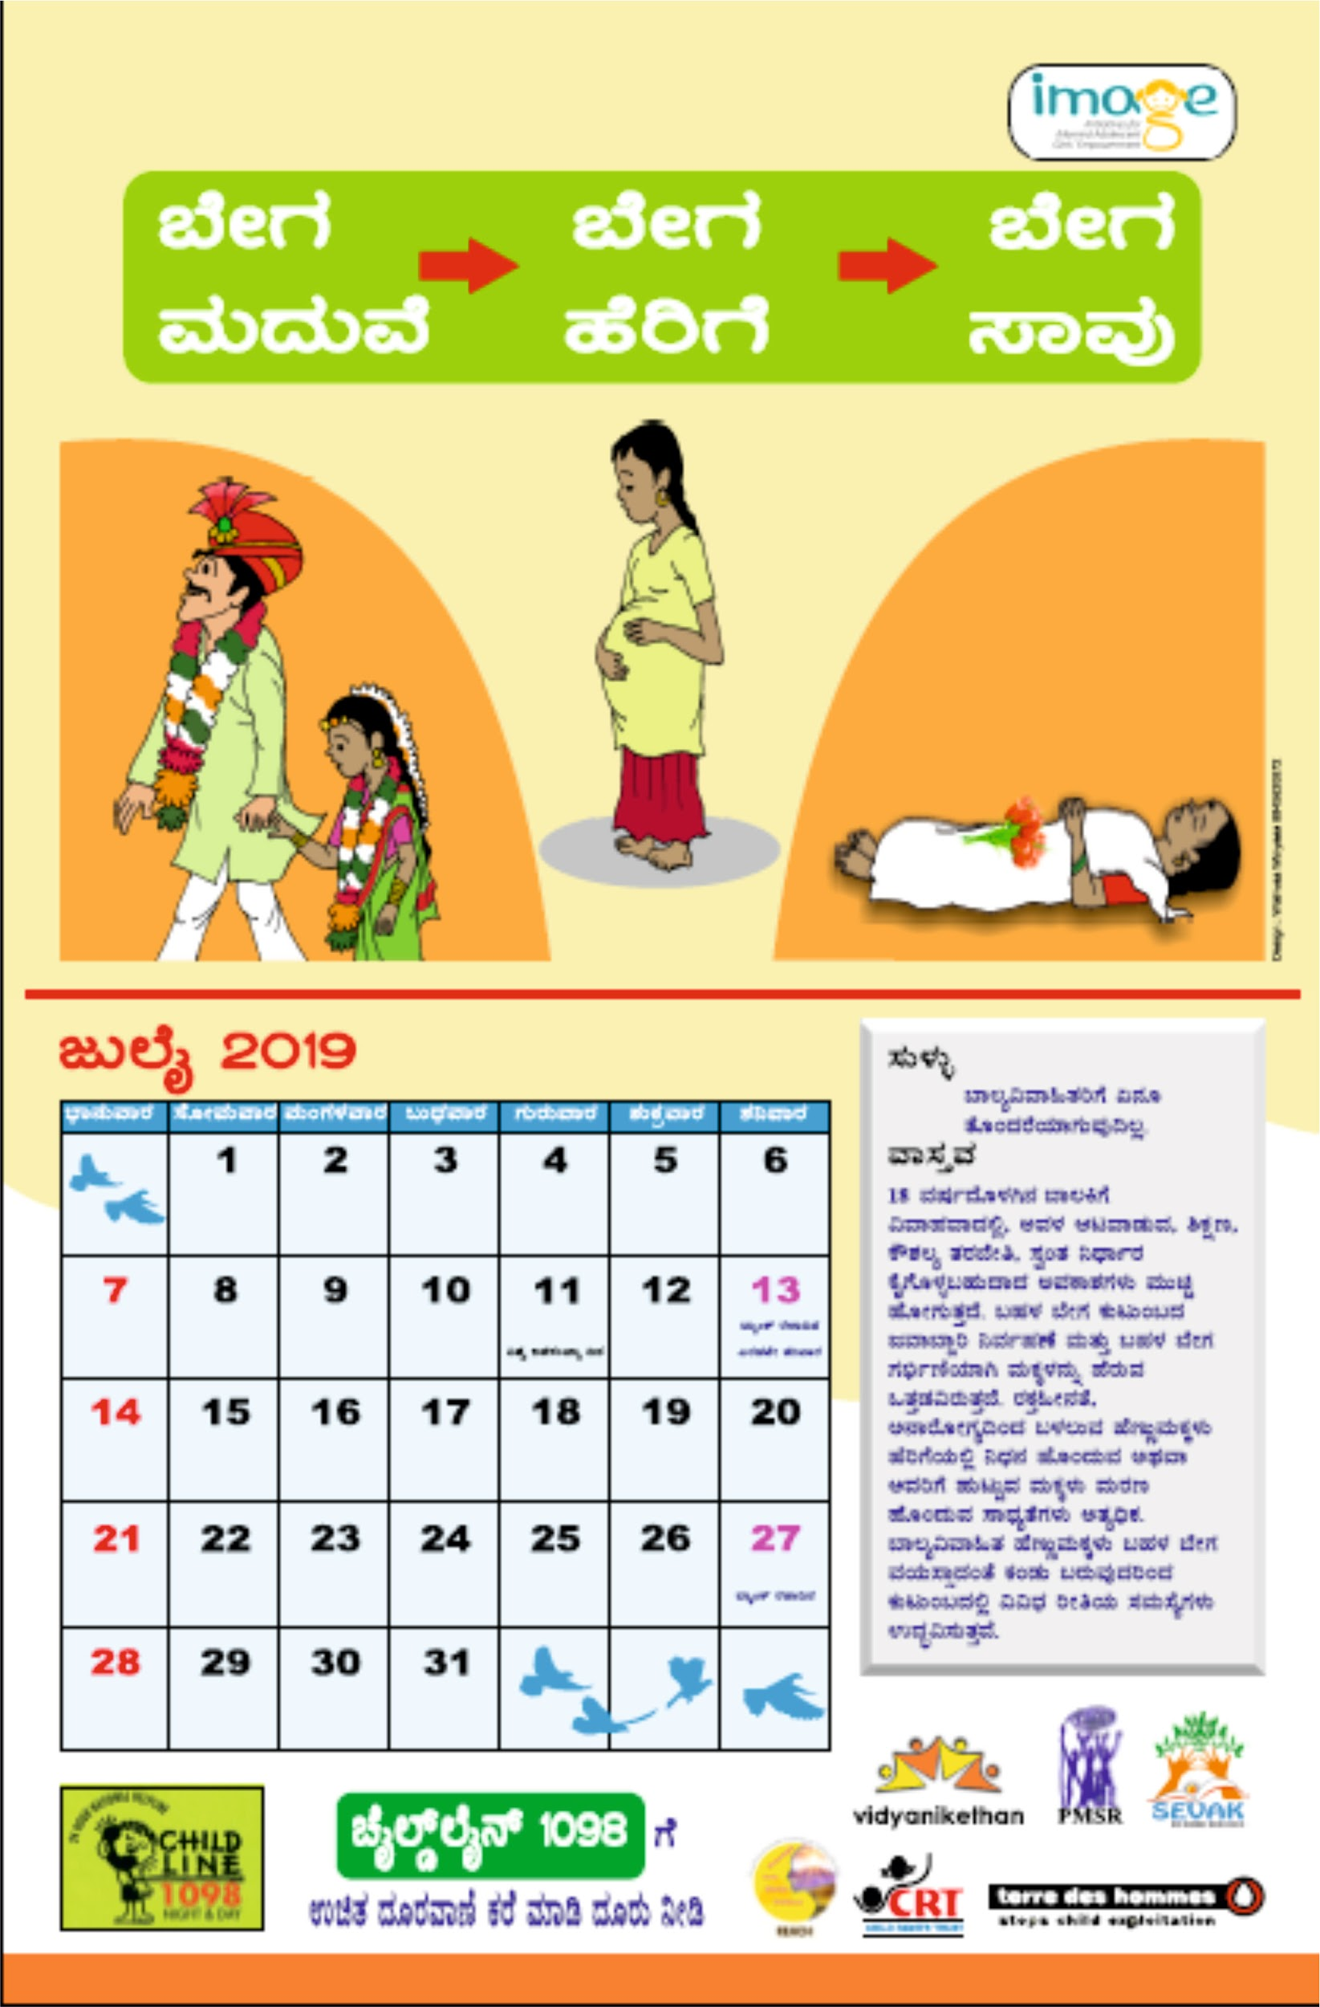
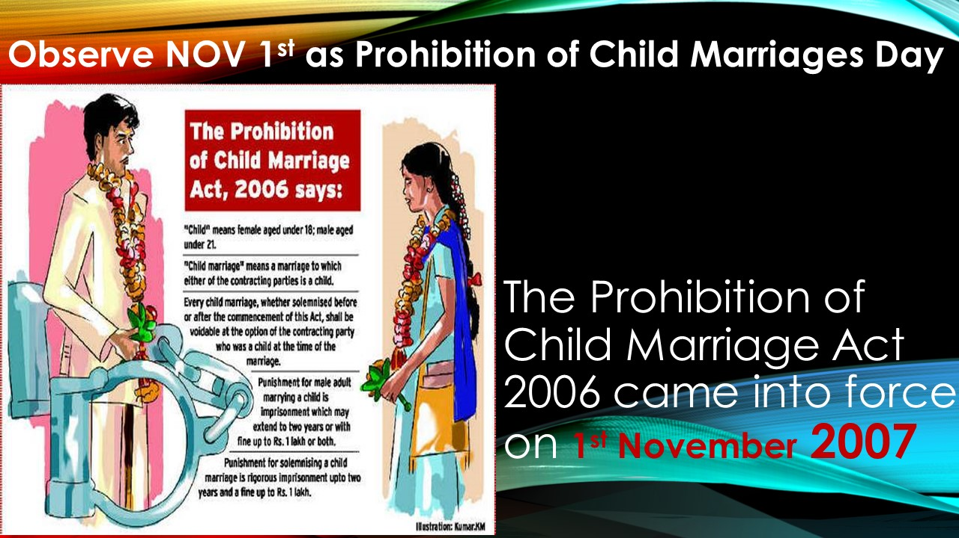

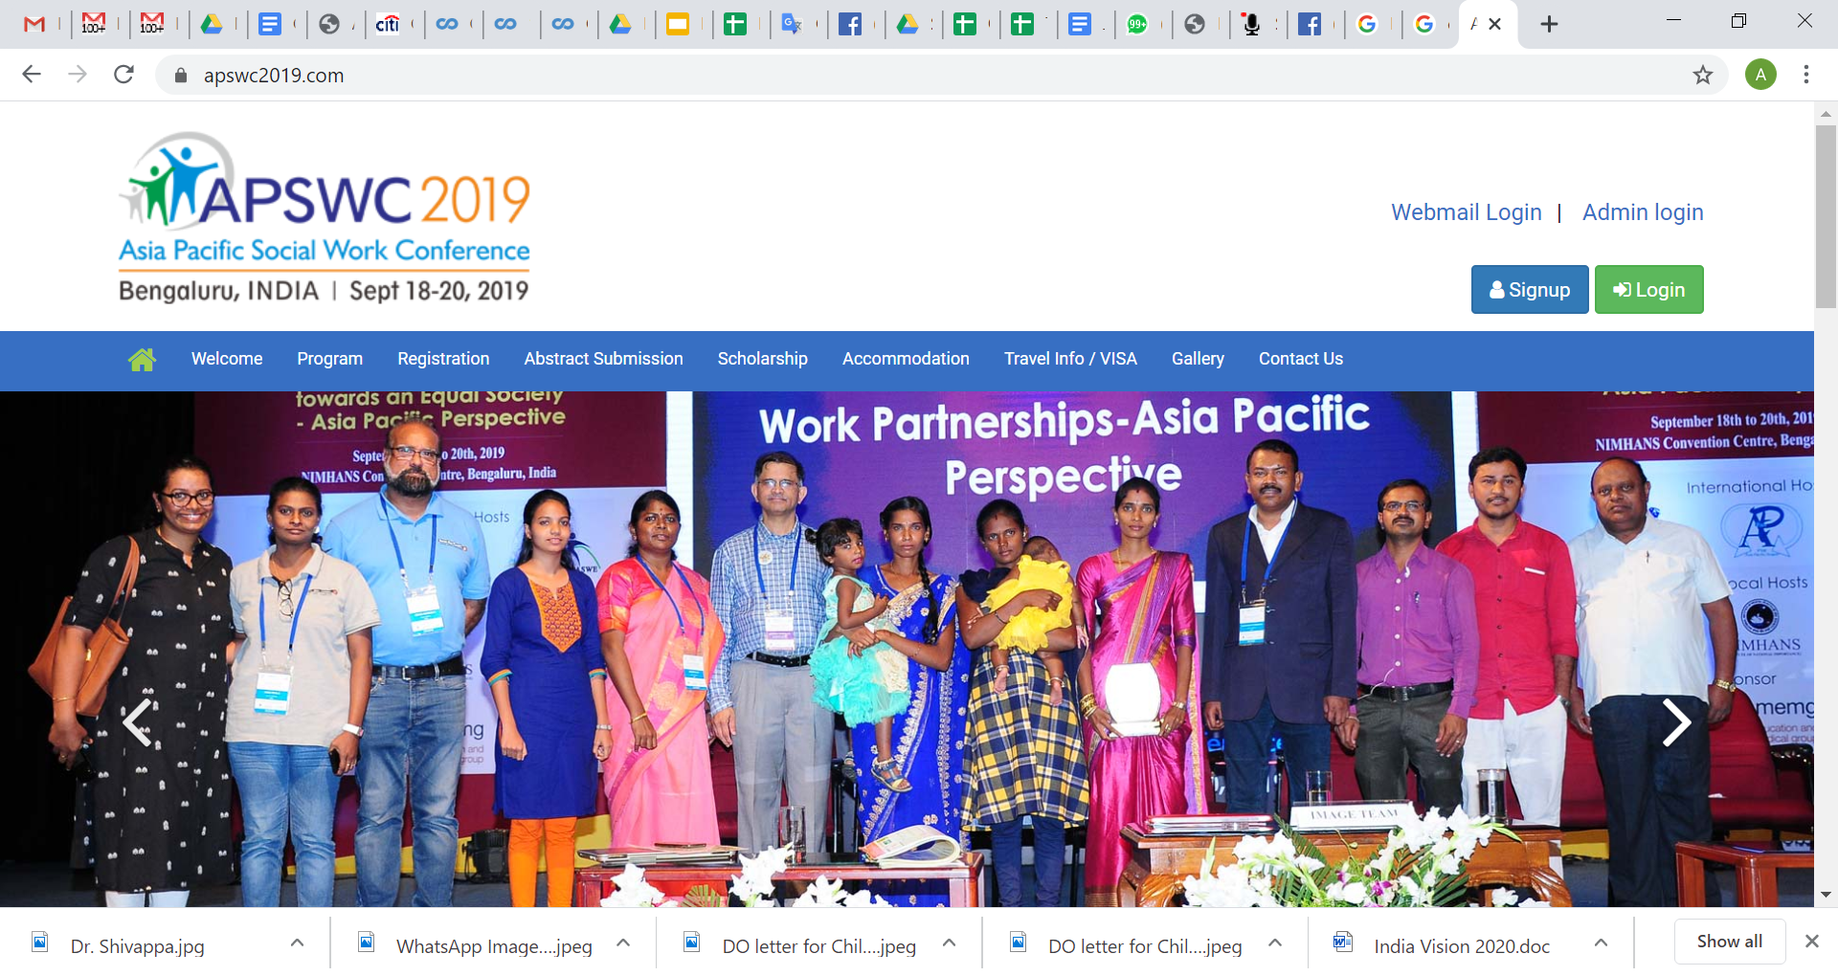
Three Innovation experimented in the year 2019
Child Marriage issues raised in Child Rights Grama Sabhas in several parts of the state - prompted by us and other IMAGE partners
Using national and international forums to raise EMG issues
IMAGE project partners utilising the calendar, newsletter and wall magazine as IEC in various programmes, meetings, workshops effectively.
PCMA Day Nov.1st (although proposed an year ago) slowly getting acceptance in Karnataka and neighbouring states

Slide 47
Five highlighted project plan for the year 2020
Media team visits to EMGs locations in the districts and PCMA workshop with media groups (more and more inquiries coming from media groups)
Need based trainings - IMAGE partner
Involving SLSA and DLSA and other govt depts
Alternative report to UNCRC Committee on implementation of CRC in India from Child Marriage Perspective (!)
Advocacy at national level to consider Nov.1st as Prohibition of Child Marriages Day.
Boys, youth and men to be included in the SRHR and GBV campaigns
Village / GP Child and Women Protection Committee strengthening and developing monitoring models

Slide 48
Highlight of plan for CCI 2020
Child Participation
State Child Rights Parliament
Child Rights Grama Sabhas
Developing Alternative UNCRC Report on EMGs
Gender Mainstreaming
Conduct Workshop to sensitise and equip on SRHR & GBV to ASHA and AWW
Sensitising men/boys on SRHR
Inclusion of CWD

Slide 49
Opportunities and identified products for RM
Opportunities
ICPS at state and district level : for training
Sensitive media which is ready to take EMGs issues in a big way
Government formed committee to address EMGs issues and prevention of child marriages
Child Rights Gramasabha to be universalised with CM as a focal issue
UNCRC Alternative Report from CM perspectives
Products identified
Editorial in Prajavani to be highlighted
PCMA Day 1st Nov to be observed at a bigger scale to draw the attention. Resource mobilisation possibilities.

Slide 50
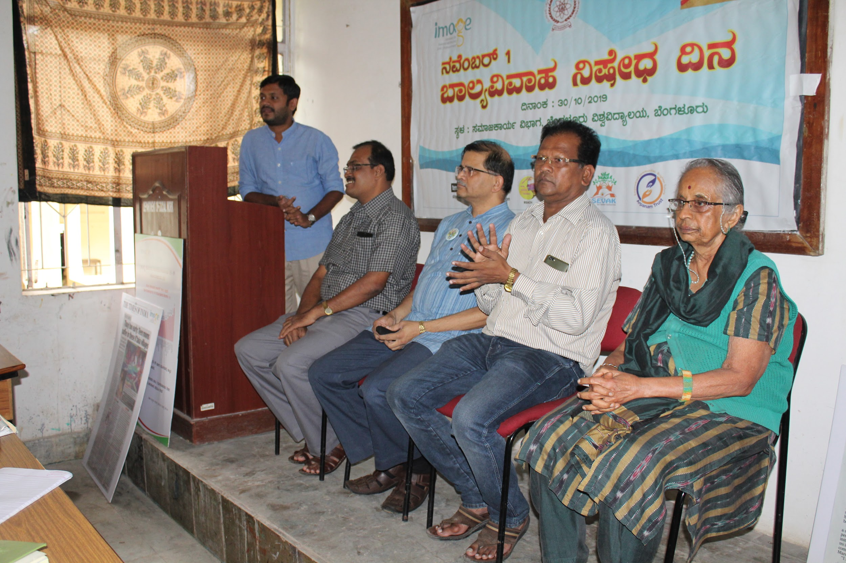
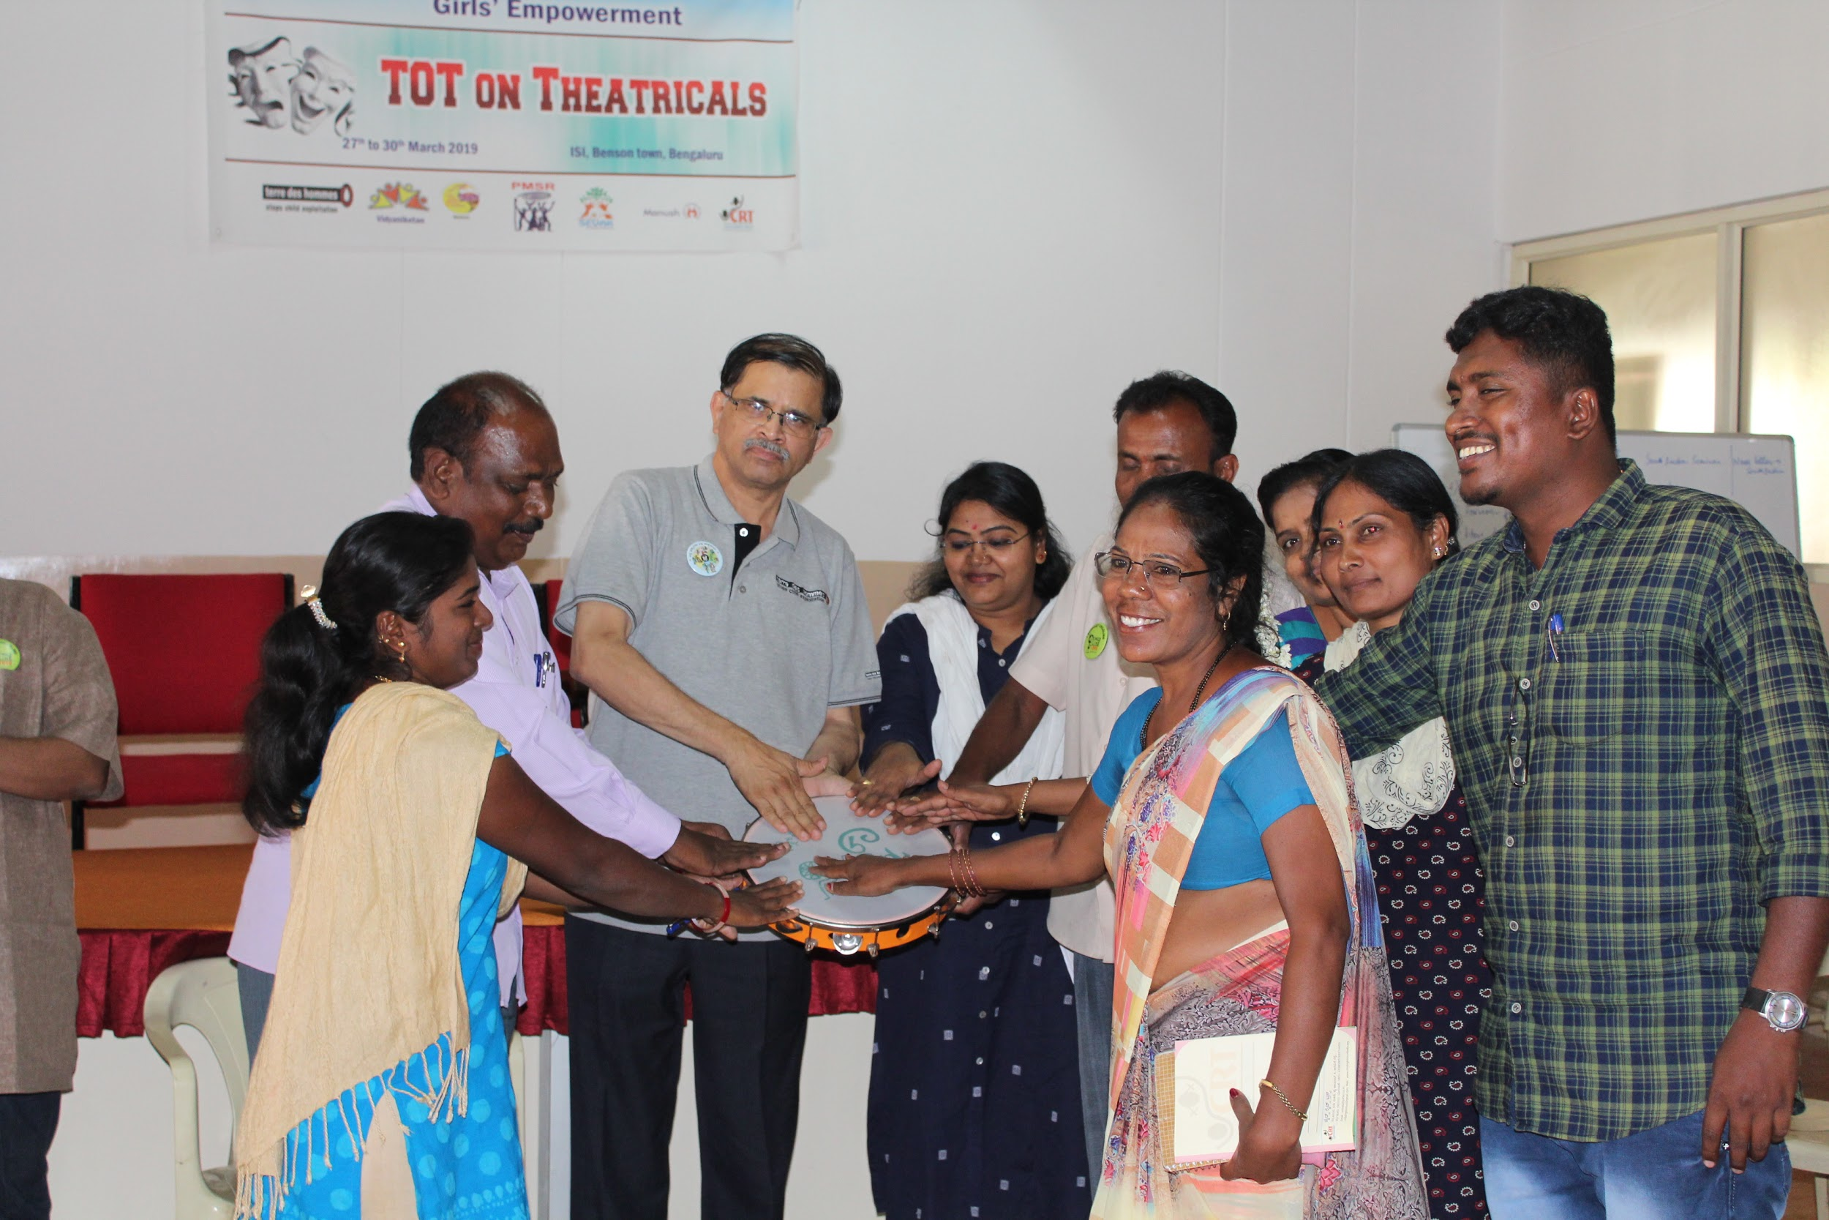
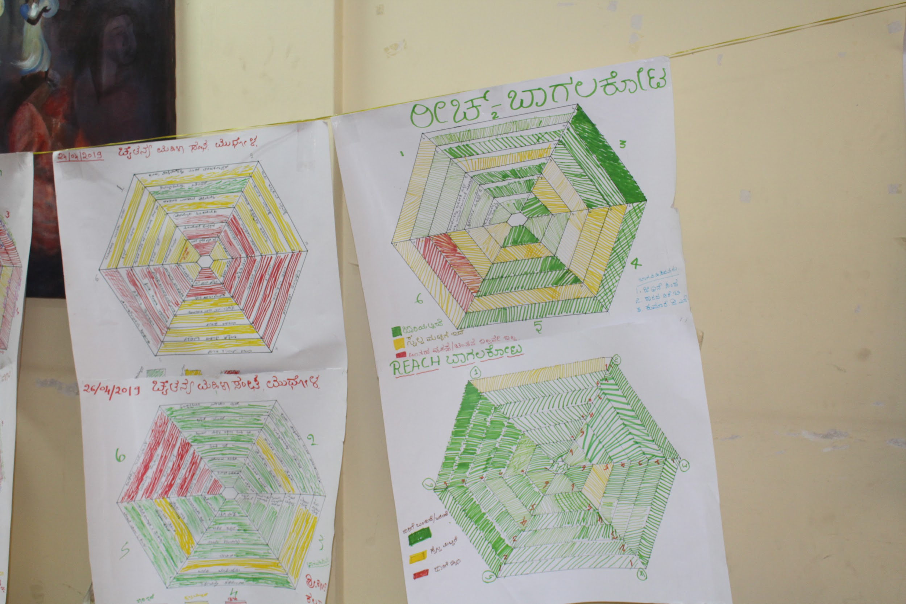
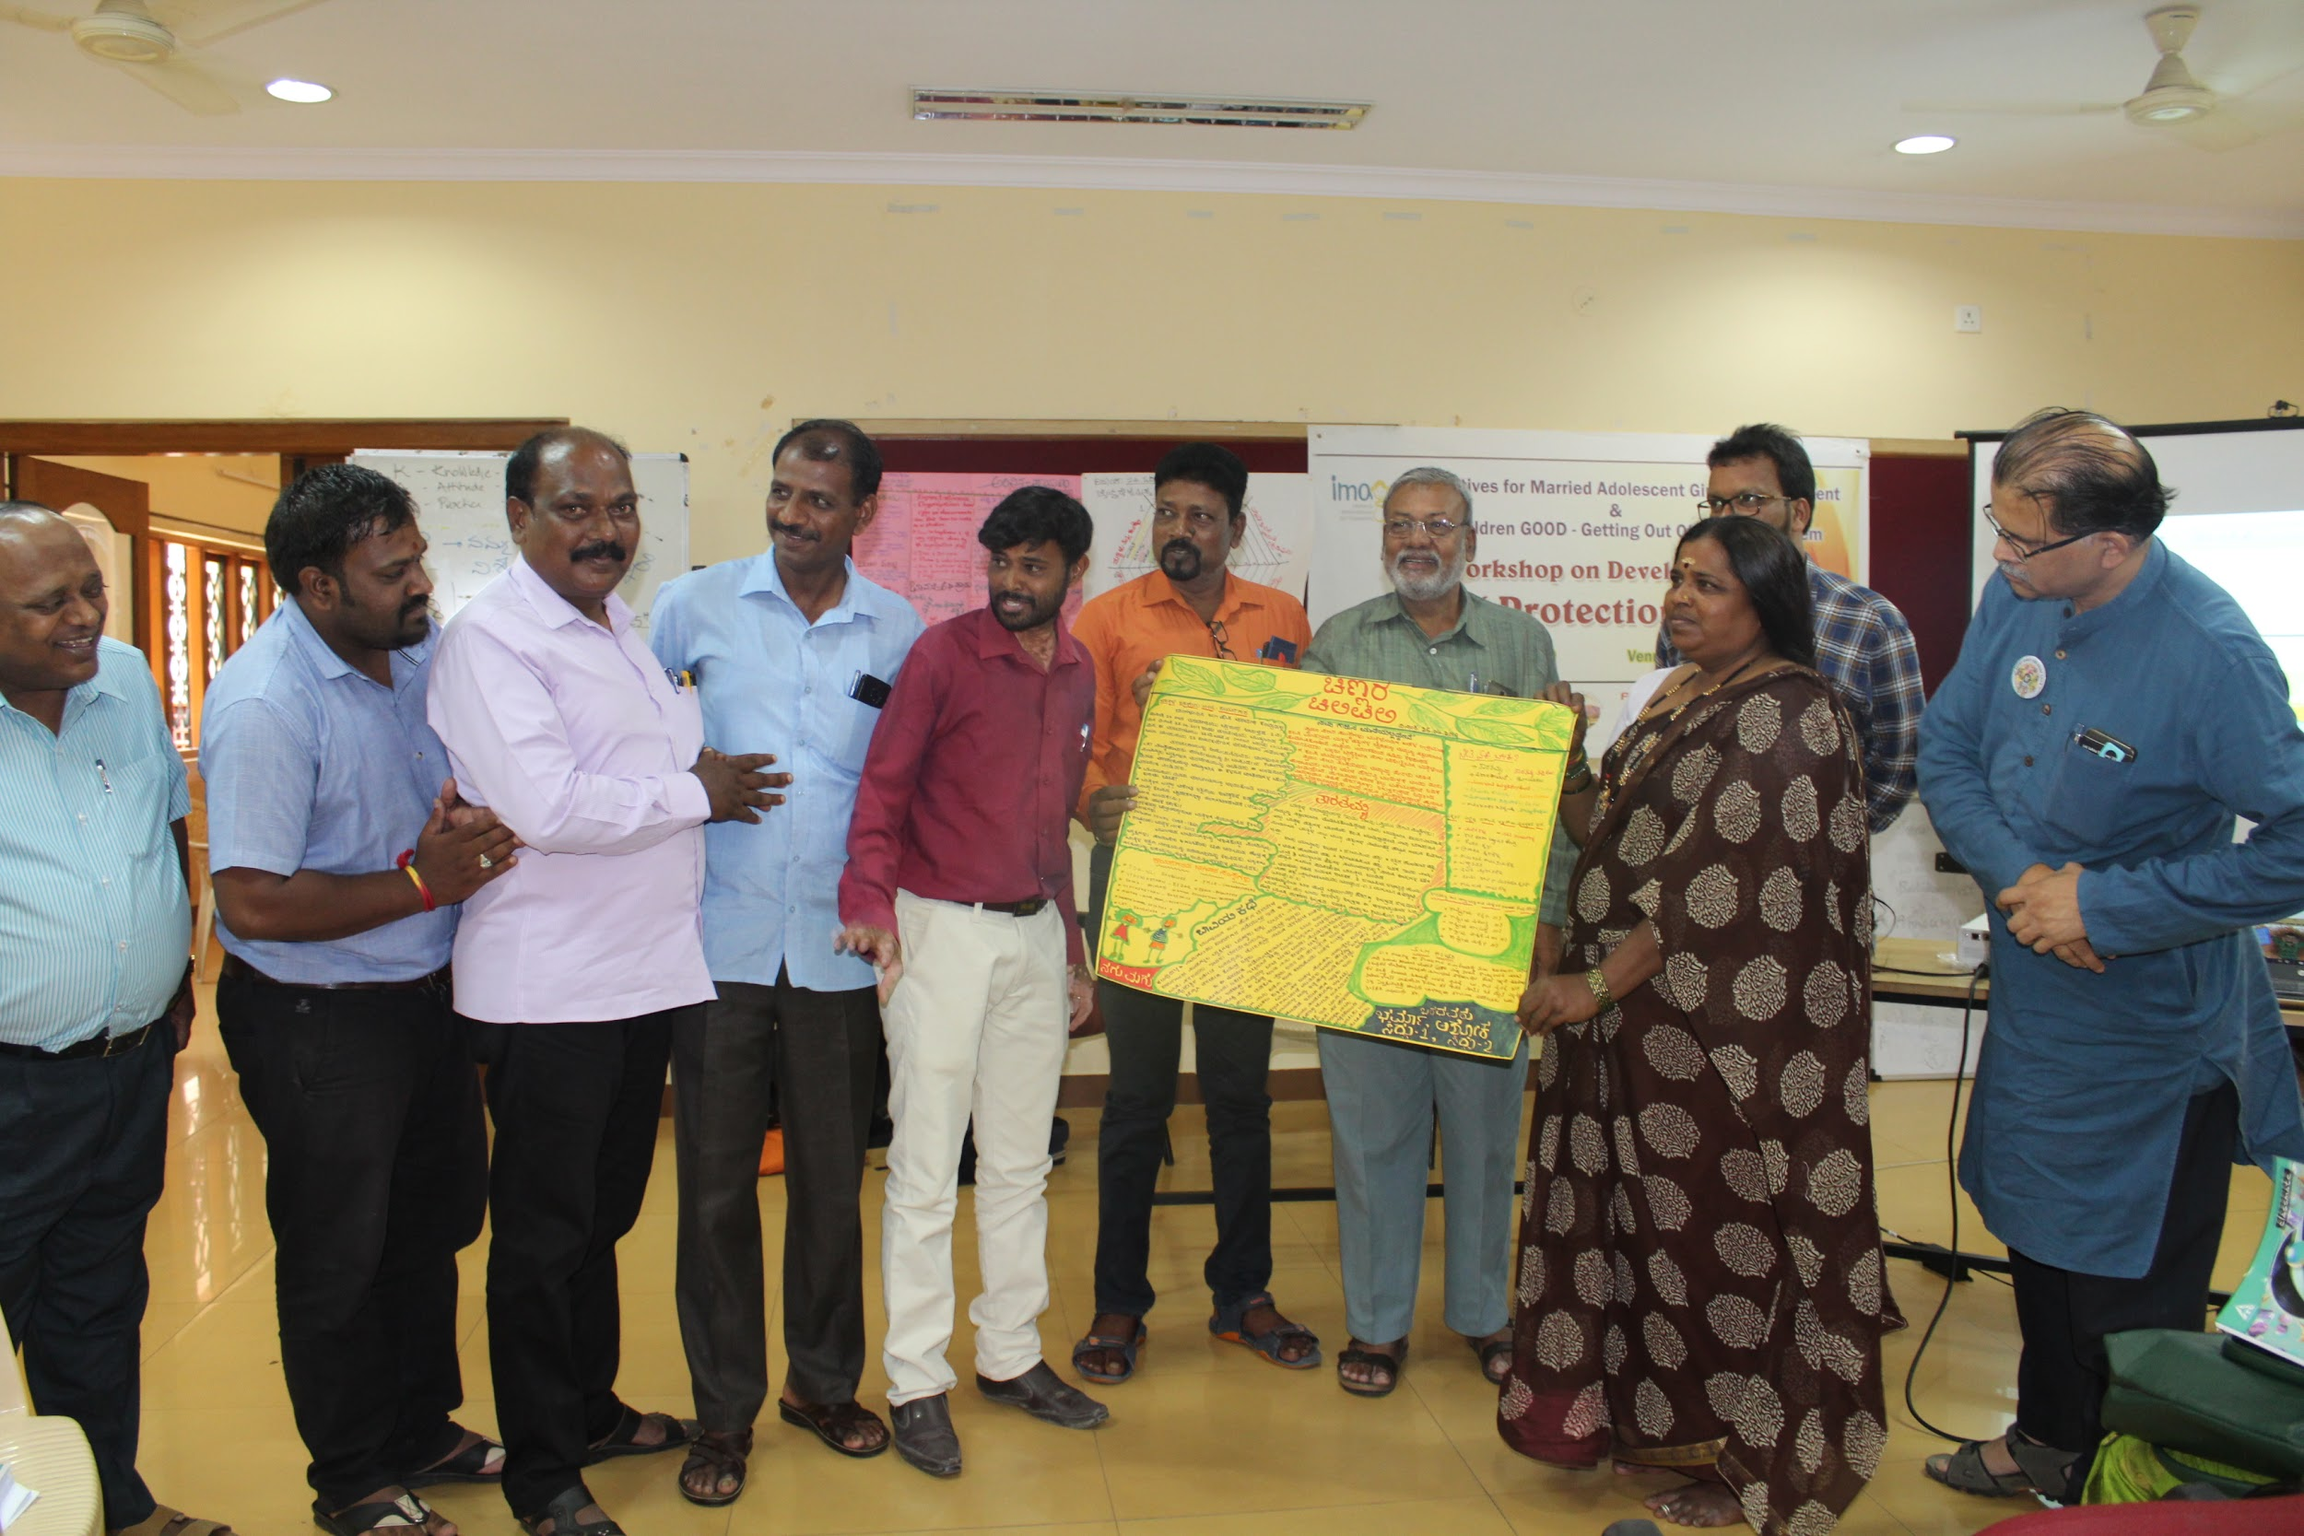
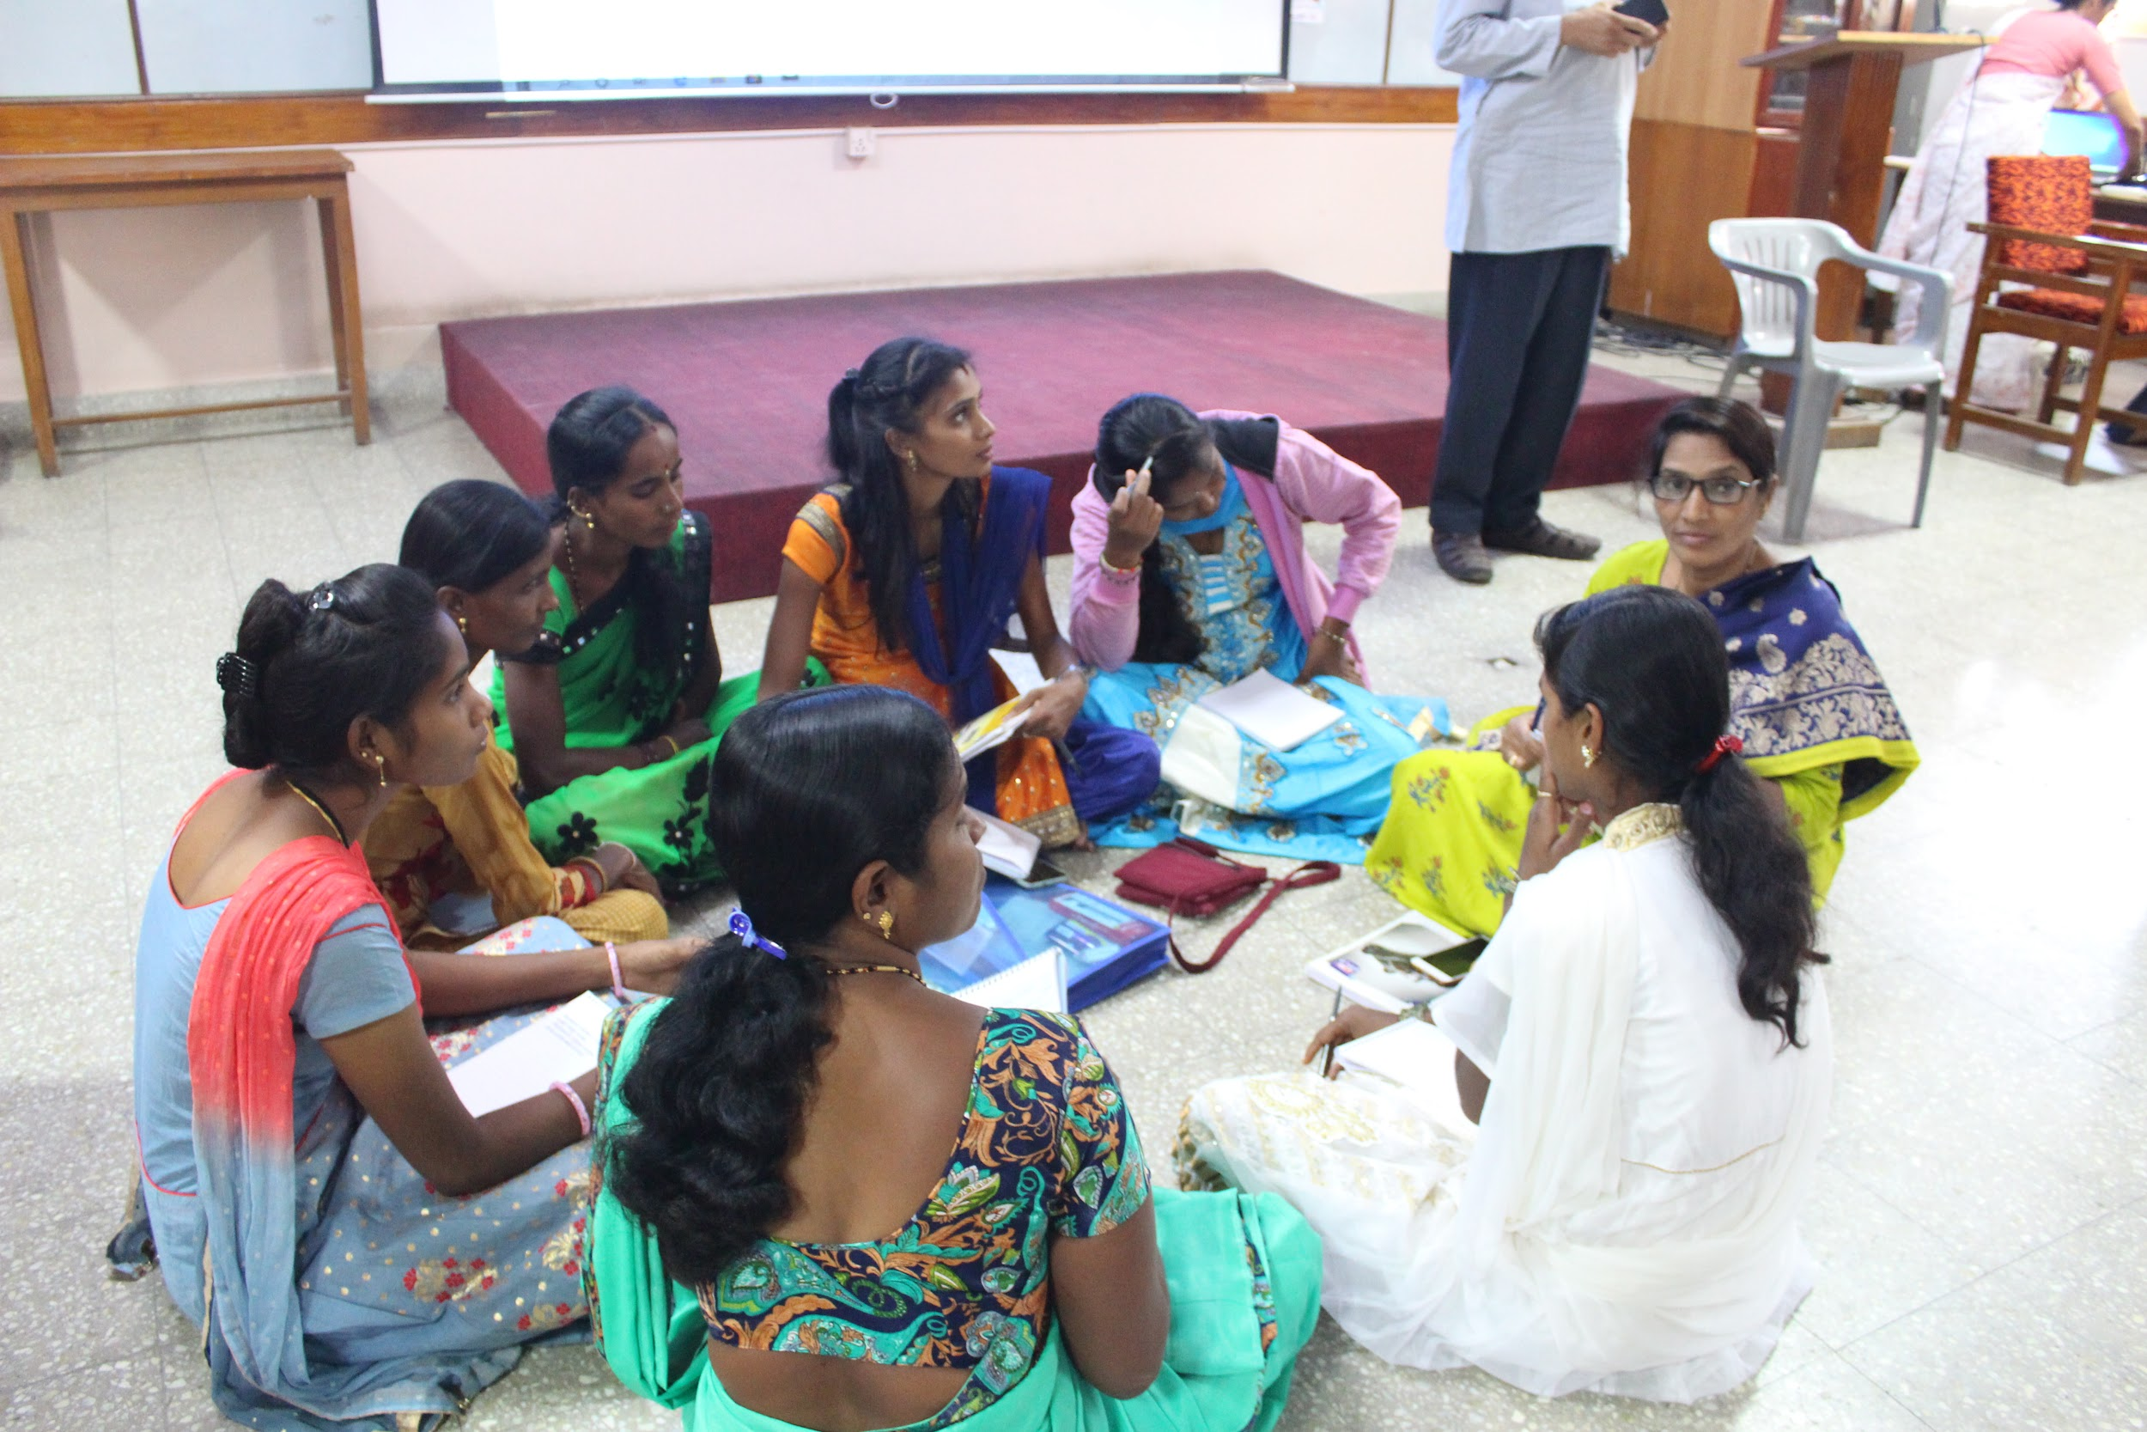
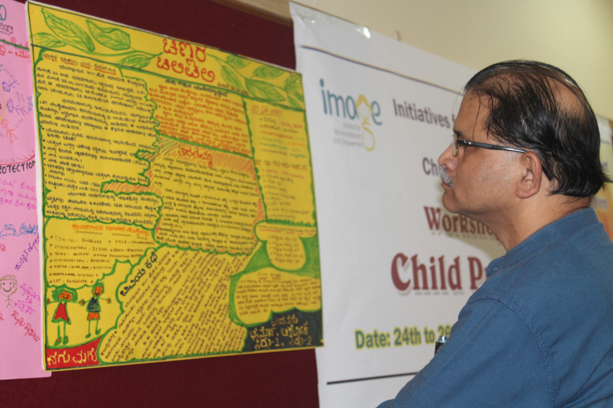
Photographs

Slide 51
TdH-NL

Slide 52
Three major achievements in the year 2019
Mobilised resources from Comic Relief fund along with consortium partners support
Programme clarity has increased among the partner staff and management
EMGs participation in programme activities has increased

Slide 53
Three major challenges faced in the year 2019
Resource Mobilisation for further expansion by involving consortium partners
Expected level of quality in both qualitative and quantitative reports; finance report to some extent OK
Collecting on-time and quality reports from partners

Slide 54
Solutions for challenges faced in the year 2019
Encourage partners to identify funding opportunities by constant consultation
Frequent feedback on the reports (still needs improvement)
Frequent monitoring and handholding support

Slide 55
Three Innovation experimented in the year 2019
TdH direct implementation in one District
Documentation of case stories (video and booklet)
Providing RF support in few locations

Slide 56
Five highlighted project plan for the year 2020
Focus more on Resource Mobilisation
Focus on documentation and reporting
Encourage and involve promotional activities along with partners
Involvement in state advocacy activities
Plan for expansion of IMAGE along with partners

Slide 57
Highlight of plan for CCI 2020
Child Participation
Capture the activities of child participation
Increase the involvement of children in planning, monitoring and evaluation process
Collect the feedback from the children and share
Gender Mainstreaming
Organise training programme on gender mainstreaming
Ensure case studies on gender mainstreaming
To support partners to have their own Gender policies
Inclusion of CWD
To support partners to update the CPP including CWDs
Ensure Identified EMGs with Disability are given top preference for inclusion
Ensure focal points in locations to take responsibility on programmes for CWD

Slide 58
Opportunities and identified products for RM
Make directory of each districts possible products for RM
Ensure sharing of information/ successes across among the partners
Possibility of establishing help desk in locations

Slide 59
Thank you!

