Slide 1

IMAGE – Karnataka
Initiatives for Married Adolescent Girls’ Empowerment
Mid term review and planning

Slide 2
IMAGE at a Glance
Overall objective
Empowering Early Married Girls towards Social and Economical Independence by Collectively Involving Govt, CSO’s and Community to be responsible in addressing the needs towards sustainability.
Specific Programme Objectives
To facilitate available health and social security services to early married girls and prevent from gender based violence & adolescent pregnancy
To facilitate increased access for early married girls to secondary education and job-oriented vocational trainings

Slide 3
Intervention
Intensive awareness raising on ill-effects of child marriage, importance of education and available education schemes to community leaders, families of vulnerable children, who has great influence on the issue of child marriage.
Capacity building of CSOs, and networks to address child marriage issues and promotion of education for early married adolescent girls.
Lobby and advocacy with Government departments for strict enforcement of child marriage acts, including Karnataka State Commission for Protection of Child Rights (KSCPCR) and State Commission for Women (SCW)
Involvement of media in preventing child marriages - as media plays an important role in publication of such issues in a positive way to address child marriage issues.
Enabling and creating access for adolescent girls for secondary education - communities lack information on available various Government schemes to access them.

Slide 4
Actors and Strategies
Actors
Early married girls
Families and communities
Government
Civil Society organisations
Strategies
Prevention
provision
promotion

Slide 5
Consortium partners
Lead - Vidyanikethan
Technical partners - TdH-NL & CRT
Implementing partners
SEVAK – Belgaum
Vidyanikethan – Bidar
REACH – Bagalkot
PMSR – Chamarajanagara
TdH-NL – Chikkaballapura

Slide 6
SEVAK, Belagavi

Slide 7
Reach
No of EMGs reached : 608
No of vulnerable children reached : 172
Social mobilisation
Groups | No of groups | Members covered | Yet to enroll
EMGs/Kishori clubs | 10 / 12 | 82 / 172 | 100 / 0
Children clubs | 27 | 696 | 0
Spouse clubs | 24 | 446 | 0
Family clubs | 24 | 486 | 0

Slide 8
Services provided - SRHR
Services | Direct services |  | Indirect Services
 | EMGs covered | Remarks | EMGs covered | Remarks
Postponement of Pregnancies | 5 | Through motivating EMGs, spouses and in-laws and adopting spacing methods devices | 10 | Through ASHAs
Spacing between two children | 19 | Through health awareness, counselling and motivating the EMGs and spouses | 36 | Through intervention of ASHAs
Family planning | 14 | Tubectomy | 19 | Through ASHAs
Reproductive health care | 72 | Through health camps, referral services to hospitals | 170 | Through intervention of ASHA, ANMs, AWWs and local PHCs
Safe Menstrual cycle | 34 | Through medical intervention with the assistance of project funds | 23 | Through intervention of ASHA and ANMs
Others

Slide 9
Services provided - Education
Services | Direct services |  | Indirect Services
 | EMGs covered | Remarks | EMGs covered | Remarks
Formal | 0 | 32 EMGs identified and are followed up for providing Educational services during current academic year | 0 | ---
Informal | 0 | -- | 0 | ---
Vocational Training | 224 | Tailoring, computer, beautician, woolen knitting, home decorative items, Dairying, goat rearing | 0
Tuition services | 0 | --- | 0 | ---
Others

Slide 10
Services provided - GBV
Services | Direct services |  | Indirect Services
 | EMGs covered | Remarks | EMGs covered | Remarks
IEC/BCC materials produced | 215 | Through usage of IEC materials and counselling by Project Team | 280 | Through ASHAs house visit using IEC
Awareness creation | 432 | Trainings, house visits by Field staff, counsellings, case interventions | 150 | By ASHAs
Legal referral given | 2 | DLSA, SWADHAR Kendra | 0
Others

Slide 11
Services provided - Health and Nutrition
Services | Direct services |  | Indirect Services
 | EMGs covered | Remarks | EMGs covered | Remarks
Supplementary vitamins and nutrition | 97 | Supplementary Nutrition (multivitamins) provided (Vitamin Angels) | 162 | Through local PHCs and Health Department
Health check ups | 87 | Referral cases to Private hospitals and through organising medical check ups | 53 | By ASHAs
Nutritious counselling | 191 | Through Counselling, House visits and awareness through video clippings | 113 | House visits and counselling by ASHAs
Awareness | 507 | Through awareness and video clippings | 0
Others

Slide 12
Services provided - Social protection
Services | Direct services |  | Indirect Services
 | EMGs covered | Remarks | EMGs covered | Remarks
Awareness creation on various civic IDs and entitlements | 357 | Awareness on Aadhar card, Ration card, Bank Account, Mathru poorna bhojana, Mathru Vandana, Swacch Bharat, Ujjwala Gas, Sukanya Samruddhi Yojana, Atal Pension Yojana etc | 120 | ASHAs and AWWs on Mathru Poorna Bhojana and Mathru Vandana schemes.
Availment of various civic IDs and entitlements | 171 | Aadhar Cards, Swachh Bharat (toilet), Bank Account, Ujwala Gas connecton, Sukanya Samruddhi, Matru Poorna Bhojana , Mathru Vandana Schemes, | 23 | Through local Gram Panchayats, LPG Gas Agents, ASHA and AWWs.
Others

Slide 13
Networking and collaboration
Actors | Type of Network and collaboration
CSOs | One Network at District Level comprising of 23 Civil Society organisations / NGOs formed to address the issues of children in need of care and protection
ASHA Workers | A total of 50 ASHA workers are working with the Project team as Change makers
Anganwadi | Informants on EMGs and collaborators in organising health and awareness programs
School Teachers | Collaborators for organising child rights related programmes in schools
CWC | Providing necessary care and protection of children in need of care and protection produced before it
Government officials | Providing necessary services to EMGs and their families concerned to their department
SLSA/DLSA | Legal Awareness, Legal services
Others | Childline 1098 - Referring children for need based services, Preventing Child marriages. PHCs: Providing health services

Slide 14
Progress in Cross Cutting Issues
CCIs | Progress made | Plan for next six month
Child Participation | Formation and capacity building of Children club, EMGs club, Kishori clubs, Local Project Committee, | Developing evaluation mechanisms to understand knowledge and BCC
Mainstreaming gender | Family clubs, Spouse club formation and conducting regular meeting | Case study of EMGs on Gender mainstreaming / GBV
Inclusion of CWD | Revival of Child Protection policy of SEVAK, Empanelled with Dept. of Disabled Welfare for providing services for CWD | Providing need based services for CWD
Alternative care

Slide 15
3 innovative ideas experimented in the programme (1.6 years)
Vocational training provided in groups within the village resulted in increasing the participation of the EMGs
2. Awareness on Govt. Schemes and entitlements and provision of these entitlements helped to increase rapport and trust with EMGs and their families
3. Identification of ASHAs as Changemakers, enhancing their capacities and complementing in their tasks resulted in effective participation of ASHAs in the project and providing effective health services.

Slide 16
Key Outcomes in the programme (1.6 years)
Creation of conducive environment for EMGs to voice out their concern in their families - They are heard now...
2. Attaining incoming earning skills
3. Improvement in their health - SRHR

Slide 17
3 Challenges faced during implementation (1.6 years)
Motivating EMGs for continuation of education (Education being low priority)
2. Convincing and effecting the postponement of first pregnancy of EMGs.
3. Identification and implementing feasible and viable Vocational / skill programmes for EMGs

Slide 18
Budget utilisation
Year | Approved Budget | Amount received | Amount Utilised | Reason for variation
2018 | 30,41,620 | 30,41,620 | 30,44,363 | Bank interest of Rs. 6,102 utilizes
2019 Qtr 1 | 7,48,700 | 7,48,700 | 7,51,494 | Opening Balance and Interest utilized
2019 Qtr 2 | 7,94,700 | 7,94,700 | 7,97,912 | Bank interest utilized
Total | 45,85,020 | 45,85,020 | 45,93,769

Slide 19
REACH, Bagalkot

Slide 20
REACH
No of EMGs reached : 609
No of vulnerable children reached : 368
Social mobilisation
Groups | No of groups | Members covered | Yet to enroll
EMGs/Kishori clubs | 11/15 | 118 / 236 | 140
Children clubs | 24 | 642 | 140
Spouse clubs | 27 | 114 | 0
Family clubs | 14/11 | 326/118 | 0/60

Slide 21
Services provided - SRHR
Services | Direct services |  | Indirect Services
 | EMGs covered | Remarks | EMGs covered | Remarks
Postponement of Pregnancies | 12 | Awareness and motivating EMGs & her family for health effects and Services of mother & child. | 16 | ASHA & SNEHA Clinic
Spacing between two children | 16 | Awareness creation and counselling | 13 | ASHA
Family planning | 06 | Through awareness and counseling | 18 | ASHA
Reproductive health care | 56 | Organized the health camps, referral to Health services. | 86 | ASHA
Safe Menstrual cycle | 96 | medical help to check ups and guidance , counseling , Pads provided | 46 | ASHA
Others

Slide 22
Services provided - Education
Services | Direct services |  | Indirect Services
 | EMGs covered | Remarks | EMGs covered | Remarks
Formal | 32 | 14 EMGs identified out of the school we are follow up for providing Educational services present year | 0
Informal | 0 |  | 0
Vocational Training | 141 | Tailoring, computer, Julawire knitting - home decoration items. | 0
Tuition services | 0 |  | 0
Others

Slide 23
Services provided - GBV
Services | Direct services |  | Indirect Services
 | EMGs covered | Remarks | EMGs covered | Remarks
IEC/BCC materials produced | 218 | SRHR and health related printed IEC materials distributed | 290 | IEC Material used the Programs.
Awareness creation | 416 | Trainings, hose visits by Field staff, counselling, case interventions | 80 | ASHA intervention
Legal referral given | 9 | Refer to DLSA and sheltered the Ujjwala Greh | 0
Others

Slide 24
Services provided - Health and Nutrition
Services | Direct services |  | Indirect Services
 | EMGs covered | Remarks | EMGs covered | Remarks
Supplementary vitamins and nutrition | 68 | Supplementary Nutrition | 96 | ASHA & WCD Dept
Health check ups | 86 | Health check up | 60 | ASHA worker
Nutritious counselling | 240 | Home visits and awareness through video clips & Counseling, | 132 | AHSA
Awareness | 340 | Programs and film Shows | 0
Others

Slide 25
Services provided - Social protection
Services | Direct services |  | Indirect Services
 | EMGs covered | Remarks | EMGs covered | Remarks
Awareness creation on various civic IDs and entitlements | 278 | Awareness on Aadhar card, Ration card, Bank Account, Swacch Bharat, Sukanya Scheme etc | 86 | SHG & Asha worker motivate and using the toilets.
Availment of various civic IDs and entitlements | 180 | Aadhar Cards, Swachh Bharat (toilet), Bank Account, Sukanya Scheme, Matru Poorna Scheme, | 48 | Toilets using avoid the open defecation.
Others

Slide 26
Networking and collaboration
Actors | Type of Network and collaboration
CSOs | DVANI Network at District Level 23 Civil Society organisations / NGOs
ASHA Workers | 60 ASHA workers as a change Makers of IMAGE implement area.
Anganwadi | EMGs & Collaboration to conducted the Health & Nutrition Program
School Teachers | Organised the Child Marriage & child rights related programmes in schools and motivation of EMGs to supportive way.
CWC | Providing Necessary care and protection of children in need of care and protection produced before it
Government officials | Help to given space for Vocational training / program Hall in villages and Providing necessary service to EMGs.
SLSA/DLSA | Legal Awareness
Others | CHILDLINE -1098 - Referring children for need based services, Preventing Child marriages. PHCs: Providing Health Services.

Slide 27
Progress in Cross Cutting Issues
CCIs | Progress made | Plan for next six month
Child Participation | Formation of Children clubs, Kishori Clubs, EMGs Club, Gram panchayat level Prevention of child marriage & child rights Committee, Children Parliament, Children Grama sabhas, each clubs and programs we create atmosphere of Participation mode. Children club members initiative to activate the gram panchayath level Prevention of child marriage & child rights Committee. | Formation of Taluk & Dist level Children Federation, Action plan will prepare from the Federation..
Mainstreaming gender | Clubs we discussion to create a sensitisation of gender. We concentrate both gender to involvement. | Film Screening to create awareness
Inclusion of CWD | VRW Meeting conducted and plan out the CWD to services. We referred to 1098 to booked the case for Student pass for govt Buses. They done a letter correspondence to resolve the issue. | Support to education and linkages to govt schemes
Alternative care | Sensitize the Child Rights to Child Care Institution -Training and orientation was conducted in allied of Govt deportment and crt support.

Slide 28
3 innovative ideas experimented in the programme (1.6 years)
SHG Formation and Linkages to Govt schemes to support the EMGs
2. Jula Wire knitting - Home Decoration Items Exhibition in Deshpande
Foundation to explore the EMGs Skill And IMAGE Concept.
3. CCI Training and Orientation @ District level With collaboration of
WCD.

Slide 29
Key Outcomes in the programme (1.6 years)
1.School dropout is reduced.
2.prevented the Child marriage.
3. EMGs Improve the Health Aspects.
4.Self confidences EMGs & Adolescent Girls.
5.EMGs skilled from Vocational Training & Exposure @ DF
6. Reduced Child marriage.
7.EMGs is re-enrollment to school.
8.EMGs is continued to Education.
9.EMGs concentration on hygienic.
10.EMGs Open up to Problem sharing.
11. Community empower to went the Gram panchayath for asking their rights and services.
12. Register the cases 1098 for prevention/Shelter

Slide 30
3 Challenges faced during implementation (1.6 years)
Spouse Club meetings difficulty.
2. Postpone of Pregnancy difficult for who are living in Husband &
same village families.
3. Non cooperation of Govt department and Families not given the
information of EMGs.

Slide 31
Budget utilisation
Year | Approved Budget | Amount received | Amount Utilised | Reason for variation
2018 | 30,15,620 | 30,15,620 | 30,23,784.44 | Bank Interest Included
2019 Qtr 1 | 7,76,525 | 7,76,525 | 7,60,533.82
2019 Qtr 2 | 8,67,054 | 8,67,054 | 8,30,753.98
Total | 46,59,199 | 46,59,199 | 46,15,072.24

Slide 32
PMSR, Kollegal

Slide 33
Reach
No of EMGs reached : 602
No of vulnerable children reached : 451 girls
Social mobilisation
Groups | No of groups | Members covered | Yet to enroll
EMGs/Kishori clubs | 38 | 408 | 28
Children clubs | 38 Girls/40 Boys clubs | 451/492 | 40
Spouse clubs | 22 | 229 | 0
Family clubs | 34 | 332 | 0

Slide 34
Services provided - SRHR
Services | Direct services |  | Indirect Services
 | EMGs covered | Remarks | EMGs covered | Remarks
Postponement of Pregnancies | 4 | Through awareness programmes convinced EMGs and Husbands to postpone. | 4 | Through Changemakers.
Spacing between two children | 24 | Through health awareness & counselling | 23 | Through Changemakers
Family planning | 9 | Tubectomy procedure
Reproductive health care | 43 | Through referrals to Govt. hospitals | 88 | Through Changemakers
Safe Menstrual cycle | 10 | Through referrals to PHCs & Govt. Hospitals.
Others

Slide 35
Services provided - GBV
Services | Direct services |  | Indirect Services
 | EMGs covered | Remarks | EMGs covered | Remarks
IEC/BCC materials produced | 205 | 3 sets of IEC materials produced on GBV, and one pamphlet on Child Rights |  | Changemakers distribute the Pamphlets on GBV and Child Rights.
Awareness creation | 279 | Through house visits, campaigns and counselling |  | Changemakers during house visit give awareness to EMGs and others on GBV and Child Rights.
Legal referral given | 3 | Through CWC admitted 2 EMGs in Bala Mandir and Hostel for Tribal Girls. Through Police/Court 1 EMG
Others

Slide 36
Services provided - Education
Services | Direct services |  | Indirect Services
 | EMGs covered | Remarks | EMGs covered | Remarks
Formal | 3 | 2 EMGs in Std. X 1 EMG in Std. IX
Informal | 7 | 4 EMGs to write SSLC Exam. 3 EMGs to write PUC Exam
Vocational Training | 212 | 152 EMGs Saree Designing Trg. 55 EMGs Tailoring Course 10 EMGS Basic Computer Course
Tuition services |  | (Next three Quarters Tuition classes will be arranged)
Others

Slide 37
Services provided - Health and Nutrition
Services | Direct services |  | Indirect Services
 | EMGs covered | Remarks | EMGs covered | Remarks
Supplementary vitamins and nutrition |  |  | 103 | Through Changemakers
Health check ups | 75 | Through referring cases to Private Hospitals and Laboratories | 21 | Through Changemakers
Nutritious counselling | 158 | Through house visits
Awareness | 203 | Awareness using Pictures/IEC
Others

Slide 38
Services provided - Social protection
Services | Direct services |  | Indirect Services
 | EMGs covered | Remarks | EMGs covered | Remarks
Awareness creation on various civic IDs and entitlements | 167 | Awareness on Aadar Card, opening of bank a/c., Ration Card, Maathru Poorna Yojane, Maathru Vandana, LPG Gas, Swatch Barath | 90 | Through Changemakers
Availment of various civic IDs and entitlements | 60 | Aadar card, Swatch Barath, Maathru Poorna and Maathru Vandana Yojane Schemes | 33 | Through Changemakers
Others

Slide 39
Networking and collaboration
Actors | Type of Network and collaboration
CSOs | Organized 4 meetings with CSOs for 89 representatives from 29 Organizations. They support in addressing issues of EMGs.
ASHA Workers | Besides 35 ASHA Workers who are Changemakers in IMAGE Programme, 32 ASHA workers help EMGs in taking them for treatment in Hospitals.
Anganwadi | 65 Anganwadi Staff attended Health Providers meeting organized under IMAGE Programme. They give space for IMAGE programme activities and they also participate in IMAGE programmes, help in identifying EMGs, see that all EMGs come for Nutritious Meal given for pregnant and lactating EMGs
School Teachers | 65 School Head Masters/Teachers allow the Partner NGO to conduct Childrens Clubs, child rights awareness programmes and give space for conducting meetings for Child Protection Committees
CWC | Help in safeguarding and protecting EMGs in distress.
Government officials | Positive towards IMAGE activities in empowering EMGs. Give space for vocational training to ENGs, promised suplying of Sewing Machines to vulnerable EMGs.
SLSA/DLSA
Others | Childline staff, VRWs, SDMC members, ‘Yejmaans’ (Leaders) of Communities support IMAGE Empowerment programme activities.

Slide 40
Progress in Cross Cutting Issues
CCIs | Progress made | Plan for next six month
Child Participation | 78 Children's Clubs have been started and in the club meetings share and discuss issues of child marriage, as Children’s club members inform CMPOs, Child Line, PMSR Field Facilitator. Representatives of children actively participate in 15 Child Protection Committees at the Panchayat level & 21 Village level CPCs & highlighted issues of children and EMGs. | Include them in the planning stage 2020 IMAGE Programme Proposal and get their suggestions. Involve them in the Year End Evaluation of IMAGE programme in December 2019 and
Mainstreaming gender | Women from the Community participate in Child Protection Committees regularly and speak up for issues of child protection. Members of the 15 SHG groups were given awareness on IMAGE programme, take up Gender Issues, child marriage, gender based violence, health issues and they give voluntary support. | Will include women who got married when they were children at the planning stage of 2020 IMAGE programme, get their feedback while implementing the programmes and also include them in the Year End Evaluation of IMAGE activities.

Slide 41
Progress in Cross Cutting Issues
CCIs | Progress made | Plan for next six month
Inclusion of CWD | Field Facilitators meet the special children from Karunalaya who were reintegrated with their families and guide the families in caring for them. During March-April, 2019, organised a patient identification camp for children and persons affected with cleft lip and cleft palate, 26 persons (22 children + 4 adults) were taken to Bangalore for free surgeries. (Operation Smile) For two disabled children provided a walker and a wheelchair. | Provide community based rehabilitation for the disabled children in the IMAGE Target villages
Alternative care

Slide 42
3 innovative ideas experimented in the programme (1.6 years)
Prepared a Street Play focussing on various issues of EMGs and PMSR Staff themselves enacted in the Street Play programmes.
2. Organized 3 Taluk Level Federation of Children’s Clubs
3. Involved Cluster Resource Persons (CRPs) and Block Resource Persons (BRPs) of the Education Department in the three Taluks of Chamrajnagar District in addressing the issues of child labour, child marriage and child rights.
4. Start a SHG group for EMGs, build their capacities to start a Power Silk Reeling Unit with the support of NABARD.

Slide 43
Key Outcomes in the programme (1.6 years)
42 child marriages were prevented
2. 348 EMGs have undergone vocational skill training (Tailoring, Basic Computer course, Saree Designing, Candle Making, Jwellery Making, Ear Flap making, Door Mat making using waste cloth)
3. Many EMGs have developed self confidence and become bold. They are even ready to go to nearby towns for training and for work.
4. EMGs are experiencing more freedom in their homes. In Laws and Husbands have changed their perceptions towards EMGs and look forward to sending their EMGs for more skill training.

Slide 44
3 Challenges faced during implementation (1.6 years)
In the beginning, EMGs, their Spouses/In Laws or Parents were suspicious of IMAGE programme. It was difficult to get them involved in IMAGE activities.
2. School Teachers, ANMs, Angamwadi Staff and Government Officers were negative about IMAGE programme and did not involve themselves in this activity.
3. Getting Spouses to attend IMAGE programme activities continues to be challenge.

Slide 45
Budget utilisation
Year | Approved Budget | Amount received | Amount Utilised | Reason for variation
2018 | 29,51,620 | 30,19,820 | 30,19,820 | An additional amount of Rs. 68,200 was given by TdH NL
2019 Qtr 1 | 8,03,287 | 8,03,287 | 8,03,287
2019 Qtr 2 | 7,41,305 | 7,44,908 | 7,44,908 | Amount received includes Bank Interest of Rs. 3603/
Total | 44,96,212 | 45,68,015 | 45,68,015

Slide 46
Vidyaniketan, Bidar

Slide 47
Reach
No of EMGs reached :630
No of vulnerable children reached :376
Social mobilisation
Groups | No of groups | Members covered | Yet to enroll
EMGs/Kishori clubs | 20/25 | 298/376 | 332
Children clubs | 21 | 561 | 150
Spouse clubs | 18 | 254 | 136
Family clubs | 33 | 504 | 2005

Slide 48
Services provided - SRHR
Services | Direct services |  | Indirect Services
 | EMGs covered | Remarks | EMGs covered | Remarks
Postponement of Pregnancies | 191 | 11 EMG’s adopted | 111 | Through Asha/AWW’s
Spacing between two children | 156 | 26 EMG’s Adopted | 99 | Through Asha
Family planning | 102 | 19 Adopted | 104 | -
Reproductive health care | 107 | 21 Through Referral service Health check Up | 151 | By local health camp, PHC,s ANM, Asha.
Safe Menstrual cycle | 194 | By PHC,s Sneha clinic, and Video clips showing | 135 | Through Aangan wadi
Others | - | - | - | -

Slide 49
Services provided - Education
Services | Direct services |  | Indirect Services
 | EMGs covered | Remarks | EMGs covered | Remarks
Formal | 05 | Re enrolled to School | - | -
Informal | 48 | Follow up for informal Education | - | -
Vocational Training | 130 | Tailoring, computer, candle Making. | 146 | 48 EMG’s are linked to Sharadha Rudest and local Embroidering center.
Tuition services | 57 | 3 EMG’s taking service | - | -
Others | - | - | - | -

Slide 50
Services provided - GBV
Services | Direct services |  | Indirect Services
 | EMGs covered | Remarks | EMGs covered | Remarks
IEC/BCC materials produced | 225 | By using IEC material | 194 | Rally on GBV child Marriage by support Local schools.
Awareness creation | 207 | By Training/workshop, video clip showing, kalajatha and wall painting. | 237 | By community leaders and School Teacher.
Legal referral given | 16 | 3 EMG’s are supported by local NGO’s | - | -
Others | - | - | - | -

Slide 51
Services provided - Health and Nutrition
Services | Direct services |  | Indirect Services
 | EMGs covered | Remarks | EMGs covered | Remarks
Supplementary vitamins and nutrition | 57 | Supplementary Multivitamins Syrup, Tablets. | 83 | By AWW/ Health Department
Health check up | 07 | 07 EMG’s has taken Medical check up service | 97 | Through PHC ANM, local Govt. Health Camp.
Nutritious counselling | 220 | By individual counseling and Group Discussion. | 190 | With PHC, VHND programme.
Awareness | 468 | By Video clips showing, Govt. Health Department. | 92 | Through Asha AWW/
Others

Slide 52
Services provided - Social protection
Services | Direct services |  | Indirect Services
 | EMGs covered | Remarks | EMGs covered | Remarks
Awareness creation on various civic IDs and entitlements | 137 | Awareness on Health card,(Ayushman Bharath), Labour Card, widow pension, RTE, Sukannya samrudhi, Hostel Etc. | 160 | Through AWW and Health Department
Availment of various civic IDs and entitlements | 70 | Health card,(Ayushman Bharth), Labour Card, widow pension, RTE, Sukannya samrudhi, Hostel Etc. | 91 | Through local panchyath leaders AWW.
Others

Slide 53
Networking and collaboration
Actors | Type of Network and collaboration
CSOs | •CSOS taking oath to stop Child Marriage , child abuse, child missing child trafficking and other forms of discrimination in the family and in community. And organizing training/workshop.
ASHA Workers | •Asha worker supporting and educating the princess to take care of health, hygiene. And keeping gap between postpone pregnancy.
Anganwadi | •Taking care in supplying the nutrition food to pregnancy princess, and anemic princess and supporting in stock taking of EMGs/Drop out children/child marriage.
School Teachers | Allowing project staff to form a child rights clubs and re enrolled the EMG,s to get Edcu.
CWC | They give Approval for IMAGE Activity in all villages.
Government officials | Instructing Gvt. Bodies to support to IMAGE Project activity and participating in all our programs
SLSA/DLSA | Introduce SLSA/DLSA and they are ready to support all project activity.
Others | •Religions leaders Ex.Govt. officials PRI/SHG members also supporting this project

Slide 54
Progress in Cross Cutting Issues
CCIs | Progress made | Plan for next six month
Child Participation | • 20 child Rights club formed and Trained on JJ act systems. | 3 CRC need to form
Mainstreaming gender | •20 Rallies conducted and IEC martials prepaid and distributed | Still 25 children need to Bring mainstream education.
Inclusion of CWD | •33 CWD Children enrolled to difference institution. | 21 children need to enroll to Govt. Schools
Alternative care | •23 children Refer to PHC for health checkup. •19 children supported for getting pension | 12 CWD children need to be pension

Slide 55
3 innovative ideas experimented in the programme (1.6 years)
Conducted workshop On Anti Child Marriage GBV Through IEC material and video clips to Ash worker Federation.
Conducting awareness programme on local festival days to take participate more EMG’s Families and Community Member
After conducting the Training/ workshop / Awareness Taking commitment from EMG,s Families, Community member. To avoid Child Marriage GBV in our Family and community. And If we found child marriage we will file a complaint.

Slide 56
Key Outcomes in the programme (1.6 years)
Total 276 supported to getting in skill trainings.
2. 23 CWD children supported to get pension, 6
children enrolled to Govt. Hostels, and 4 children to
blind hostel.
3. 126 EMG’s has taken Health Referrals service, now
they are feeling good in physically and Mentally

Slide 57
3 Challenges faced during implementation (1.6 years)
1.Fear and hesitation to participate in training at local institute.
2. Doing a group of only EMG,s, no matter how convincingly
Informed disagree
3. Any how give about child Marriage awareness parents have a
feeling that children will run away from home.

Slide 58
Budget utilisation
Year | Approved Budget | Amount received | Amount Utilised | Reason for variation
2018 | 2951620 | 2951620 | 2951608
2019 Qtr 1 | 799542 | 799542 | 389596.95 | FCRA Sub account was not operational, hence it was unspent
2019 Qtr 2 | 830000 | 694122 | 785207
Total | 4581162 | 4445284 | 4126411.95

Slide 59
TdH-NL, Bagepalli

Slide 60
TdH-NL-Bagepalli
No of EMGs reached : 600
No of vulnerable children reached : 523
Social mobilisation
Groups | No of groups | Members covered | Yet to enroll
EMGs/Kishori clubs | 25 | 375 | 5 Groups/75 Members
Children clubs | 30 | 295 | 0
Spouse clubs | 6 | 48 | 12 Groups/122 members
Family clubs | 6 | 48 | 9 Groups/72 members

Slide 61
Services provided - SRHR
Services | Direct services |  | Indirect Services
 | EMGs covered | Remarks | EMGs covered | Remarks
Postponement of Pregnancies | 87 Covered 2-Trainings | Out of 186 EMGs, 87 are trained on delay pregnancy. Among them 18 have adopted contraceptive measures. These 186 are not having children therefore they were targeted. | 288 | Awareness on delay pregnancy was given to EMGs in Kishorie Clubs.
Spacing between two children | 207 Covered 6-Trainings | Out of 283 EMG’s having single child, 207 are provided awareness on spacing between two children among them 48 are using contraceptive measures | 168 | Awareness on spacing between two children was given in Kishori Clubs

Slide 62
Services provided - SRHR
Services | Direct services |  | Indirect Services
 | EMGs covered | Remarks | EMGs covered | Remarks
Family planning | 81 Covered | Out of 131 EMG’s having more than two children, 81 are provided awareness on family planning among them 13 have undergone family planning (Laparoscopy) | 294 | Awareness on family planning was given in Kishori Clubs
Reproductive health care |  |  | 375 | Awareness on reproductive health care given is given in Kishori Clubs.
Safe Menstrual cycle |  |  | 375 | Awareness on safe and unsafe days for pregnancy is given in Kishori Groups.
Others

Slide 63
Services provided - Education
Services | Direct services |  | Indirect Services
 | EMGs covered | Remarks | EMGs covered | Remarks
Formal | 76 (old 62 New 14) | Provided Examination fees, Bags, guide note books & Travel to attend exams (SSLC Discontinued & Vulnerable for early marriage)
Informal | 13 | Provided Examination fees, Bags, guide note books & Travel to attend exams
Vocational Training | 86 (35 old New 51) | Provided computer, Tailoring & Beautician training
Tuition services | 13 | Individual Tutions for EMG’s-House to House
Others

Slide 64
Services provided - GBV
Services | Direct services |  | Indirect Services
 | EMGs covered | Remarks | EMGs covered | Remarks
IEC/BCC materials produced | 375 | 5 Flip charts and 3 Hand books |  | Distributed to change makers & ANM’s
Awareness creation | 303 | Through video show and short films in Kishori clubs. | 216 | 6 GBV Campaigns were conducted in that 216 EMGs participated and other 267 were from family & children clubs.
Legal referral given | 0 |  | 0
Others

Slide 65
Services provided - Health and Nutrition
Services | Direct services |  | Indirect Services
 | EMGs covered | Remarks | EMGs covered | Remarks
Supplementary vitamins and nutrition | 66 | Addressed Anemic cases
Health check ups | 74 | Referral cases through Asha workers and ANM’s for medical camps conducted by us. | 148 | Through house visits by Asha workers and ANM’s
Nutritious counselling | 264 | Counselled by our Counsellors & change makers during house visits
Awareness | 140 | Through 3 awareness camps | 121 | During house visits
Others

Slide 66
Services provided - Social protection
Services | Direct services |  | Indirect Services
 | EMGs covered | Remarks | EMGs covered | Remarks
Awareness creation on various civic IDs and entitlements | 375 | Awareness on the Prasuddhi arogya yojane, Bhagya laxmi yojane & Vidhava vedhana |  | Awareness on Amedhar vasathi yojane, Krishi yojane, Swach Bharath and NAREGA Yojane for 480 households.
Availment of various civic IDs and entitlements | 67 | Availed the Prasuddhi arogya yojane, Bhagya laxmi yojane & Vidhava vedhana Yojane. | 17 EMGs in joint family | Availed Amedhar vasathi yojane, Krishi yojane, Swach Bharath, NAREGA Yojane & Basava vasathi yojane
Others | 08 | Aadhaar card, BPL Card & Bank account

Slide 67
Networking and collaboration
Actors | Type of Network and collaboration
CSOs | District level consultation was held on issues of EMG’s & child marriage
ASHA Workers | Collaborating with Asha workers in providing direct health services and liking up with hospitals
Anganwadi | Coordinating with Anganwadi teachers as our contact person to EMG’s and Involving Anganwadi centers for our activities and delivering services to EMG’s.
School Teachers | Involving School teachers in mass campaigns, providing education services to EMG’s, Formation of children clubs and conducting IMAGE Programs
CWC | Referred 2 cases to Child Welfare Committee for care & Protection
Government officials | PHC Doctors & Taluk health officers in capacity building of change makers, involving Advocates in providing legal awareness trainings to EMG’s
SLSA/DLSA | Planning to initiate.
Others

Slide 68
Progress in Cross Cutting Issues
CCIs | Progress made | Plan for next six month
Child Participation | Emg’s actively involve in Kishori groups and express their needs, desire, feedbacks and on their rights | Formation of Kishori group Committee (representatives) for designing & planning the activities.
Mainstreaming gender | Providing an opportunity for spouses to participate in IMAGE activities to empower EMG’s. | Formation of more Spouse Clubs towards active involvement.
Inclusion of CWD | As per the data, no EMG’s with disability found. | Assessment will be done to identify children with disability among vulnerable
Alternative care

Slide 69
3 innovative ideas experimented in the programme (1.5 years)
Identified village level training institutes and decentralised the VT Center
Encouraged one of the trained EMG’s to startup her own Tailoring training center
Initiated mass awareness on judicial punishment on child marriage through wall painting

Slide 70
Key Outcomes in the programme (1.5 years)
Acceptance by community on IMAGE concept and willingness of sending EMG’s to participate in IMAGE programme
2. Active support of ANM’s, Changemakers and teachers for EMG’s to avail the services provided by IMAGE Project
3. Mass awareness on Child Marriage through Kalajatha and campaigns has contributed in gaining confidence form communities and public.

Slide 71
3 Challenges faced during implementation (1.5 years)
Initially Community defended child marriages and not willing to give details
2. Convincing the EMG’s to complete their Secondary Education
3. Spouses formation is difficult

Slide 72
Budget utilisation
Year | Approved Budget | Amount received | Amount Utilised | Reason for variation
2018 | 2951620 | 2951620 | 2530059 | Organisation Governance
2019 Qtr 1 | 818320 | 817320 | 521467 | Change of Management and initial pick up
2019 Qtr 2 | 818320 | 819320 | 858481 | Reached close but still to utilize complete budget
Total | 4588260 | 4588260 | 3910007

Slide 73
CRT, Bangalore

Slide 74
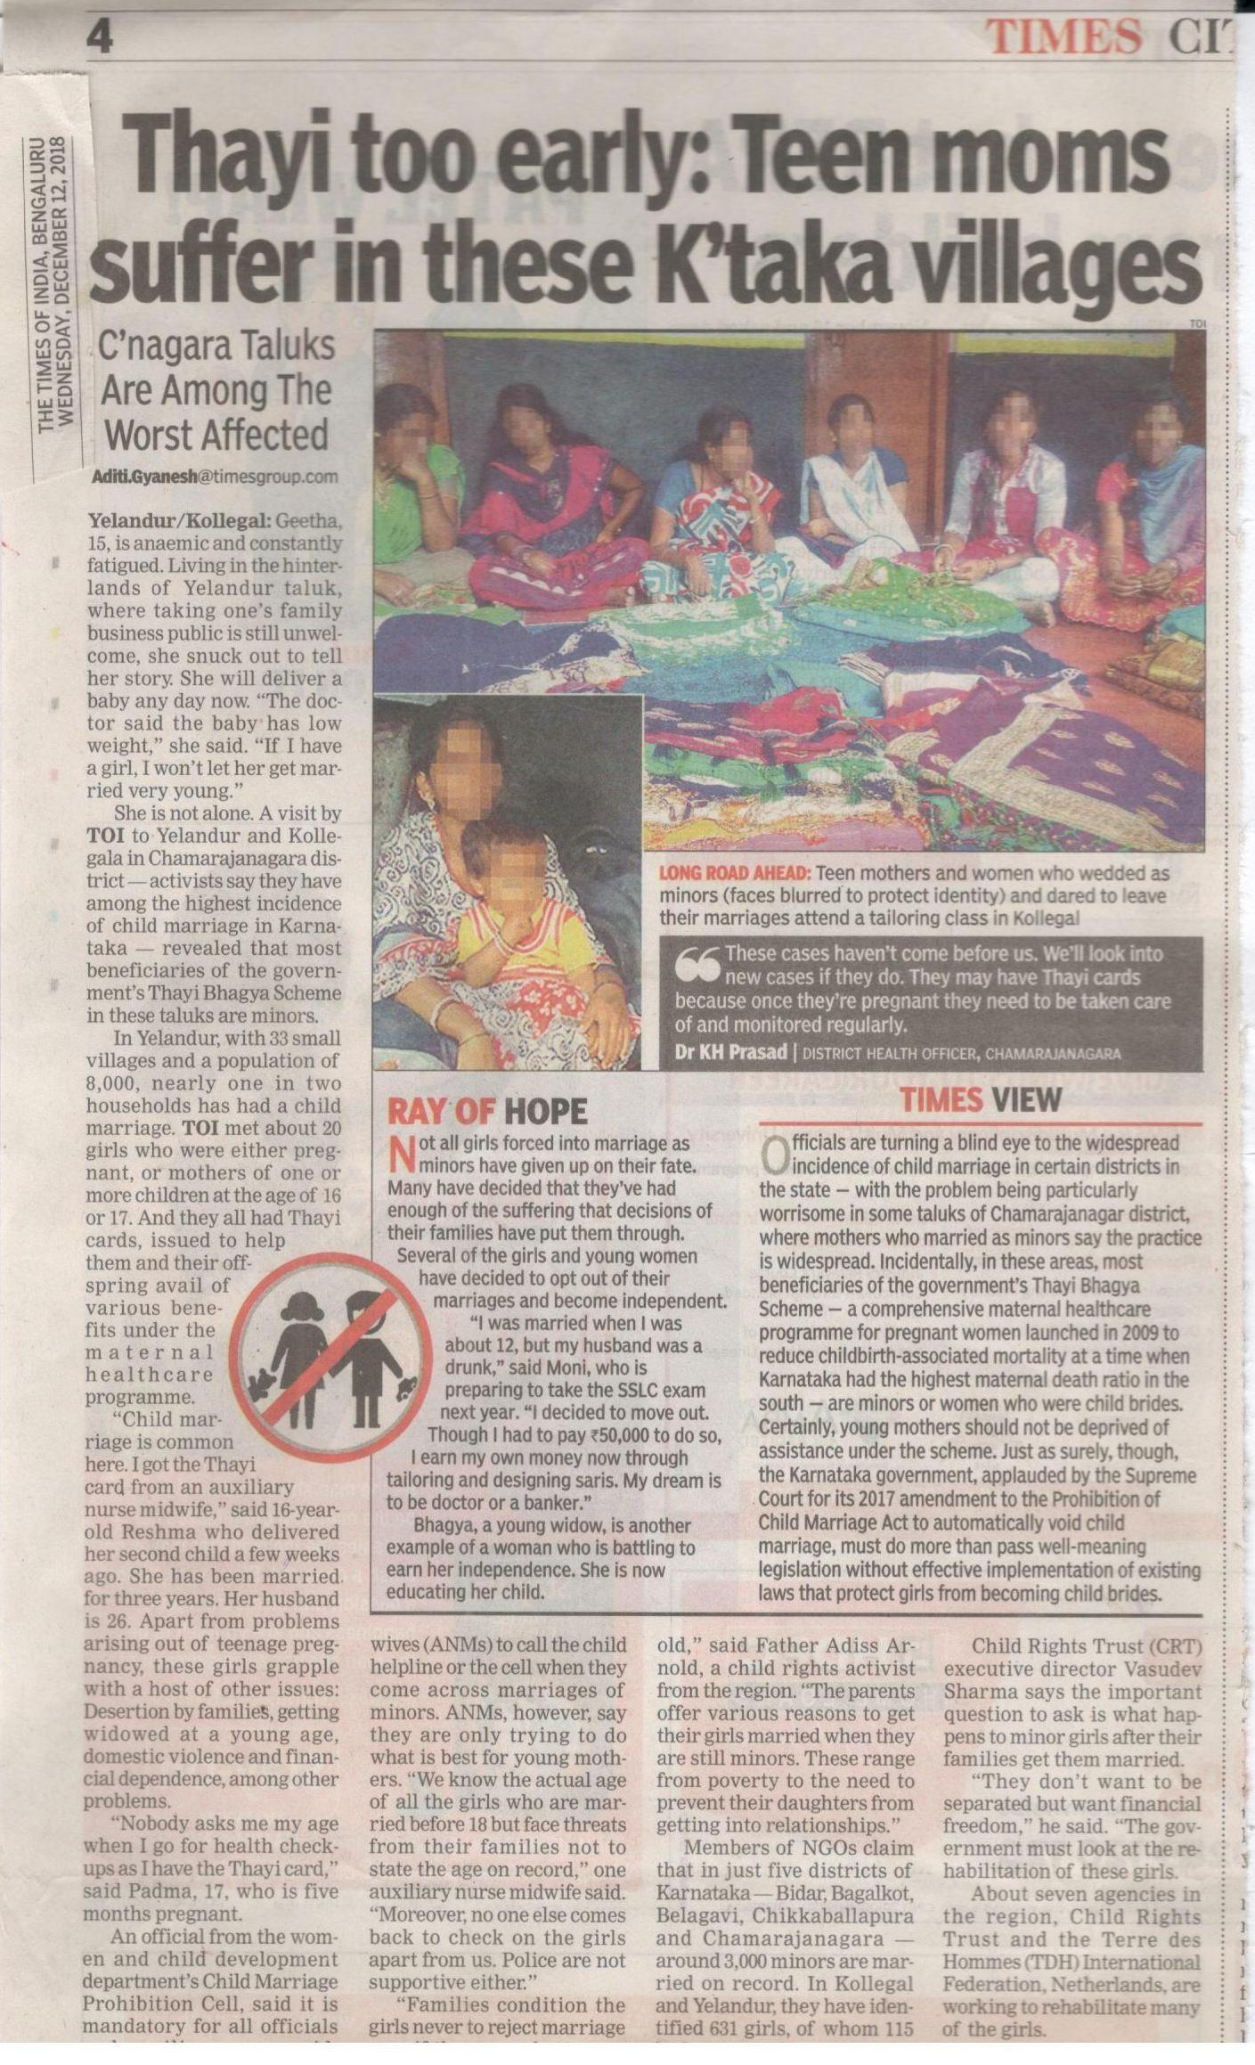

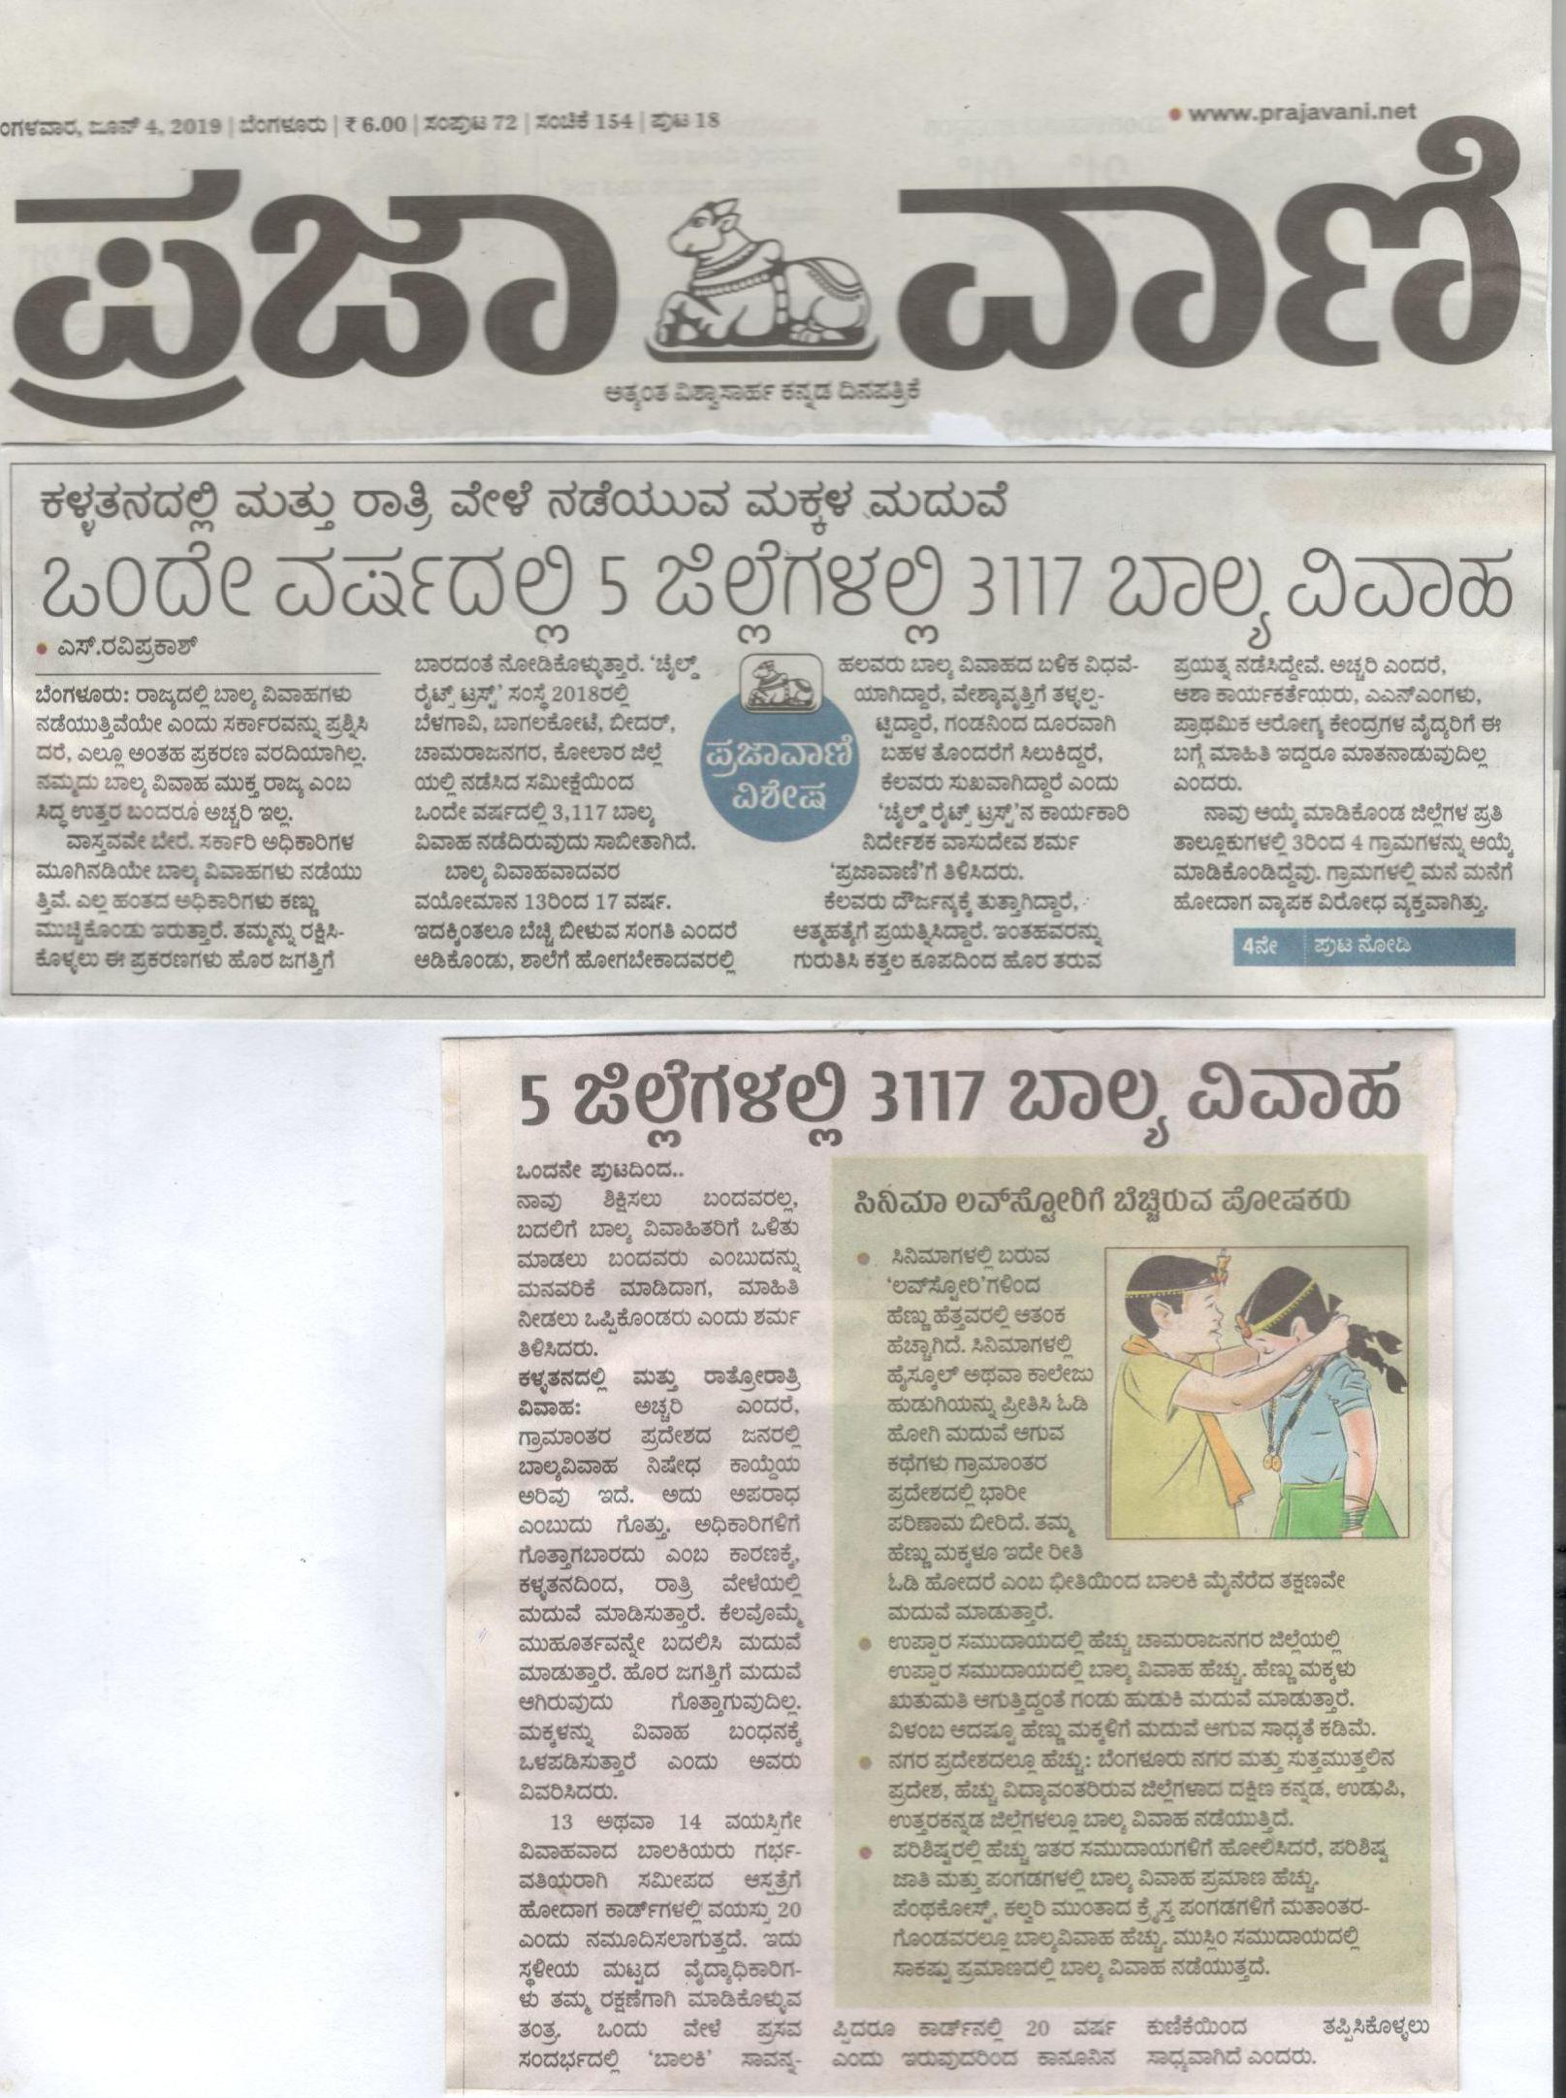
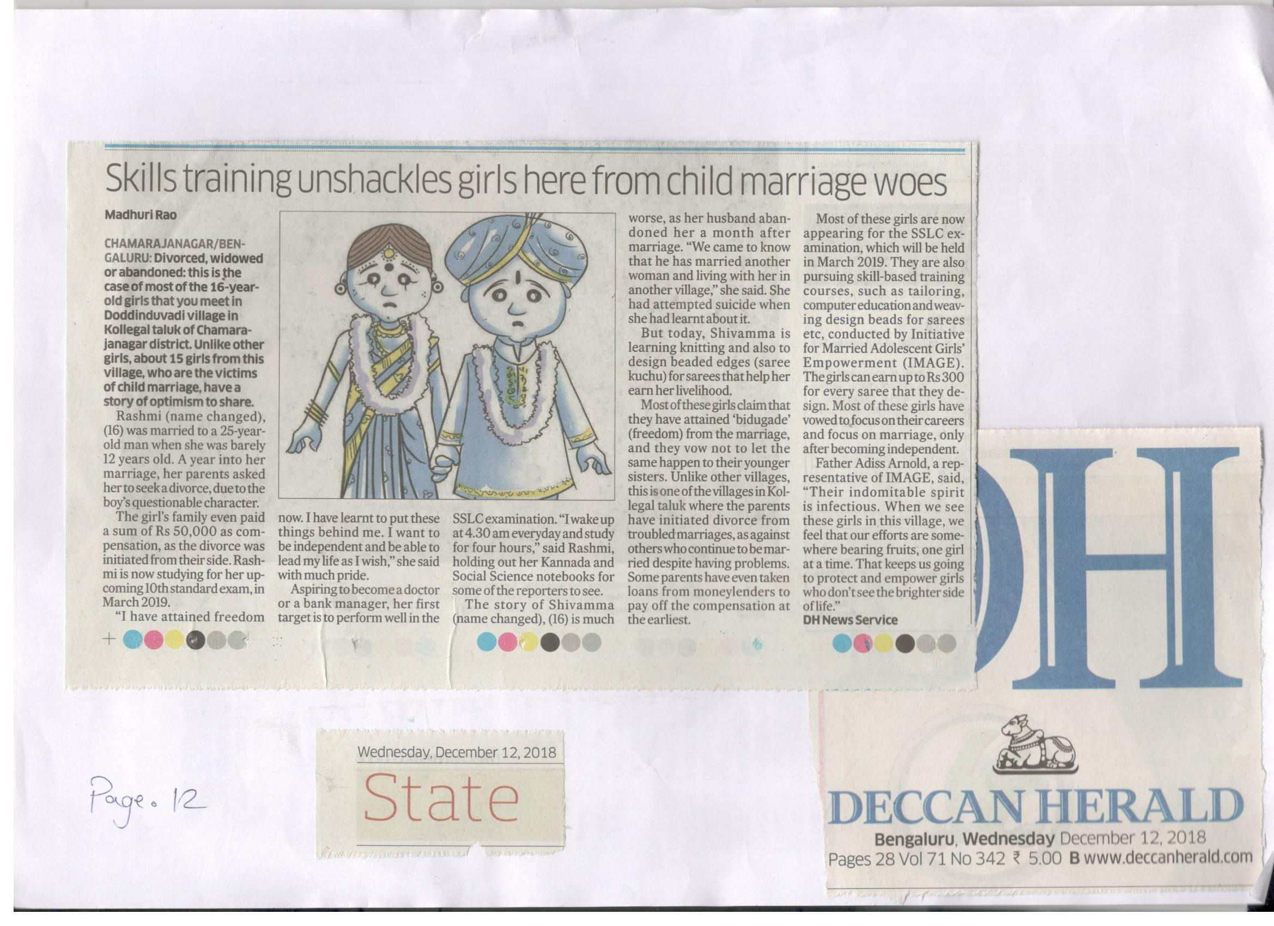
Highlights of Media campaign (1.6 years)
Ba baduku - Radioactive series -Year long- 2018
Visits by Ms. Anitha Pailoor, Deccan Herald to SEVAK and REACH and wide coverage in the newspaper - Dec, 2018
Visit by correspondents from Times of India, Prajavani, Deccan Herald and two freelancers to PMSR - Feb, 2019
Editorial on EMG issues in Prajavani - - June, 2019
Visit by correspondents from CNN Network 18 to PMSR, Chamarajanagar and TdH NL, Chikkaballapura
- June, 2019
Notes:
T

Slide 75
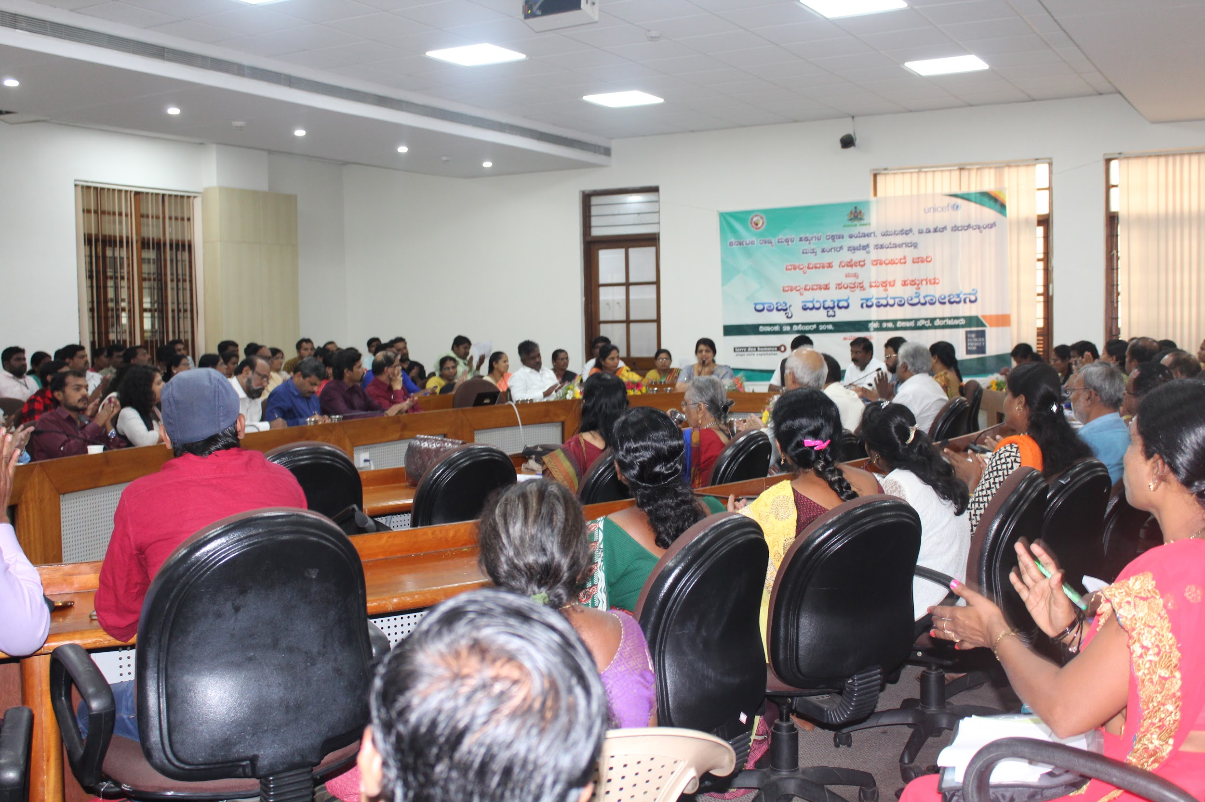
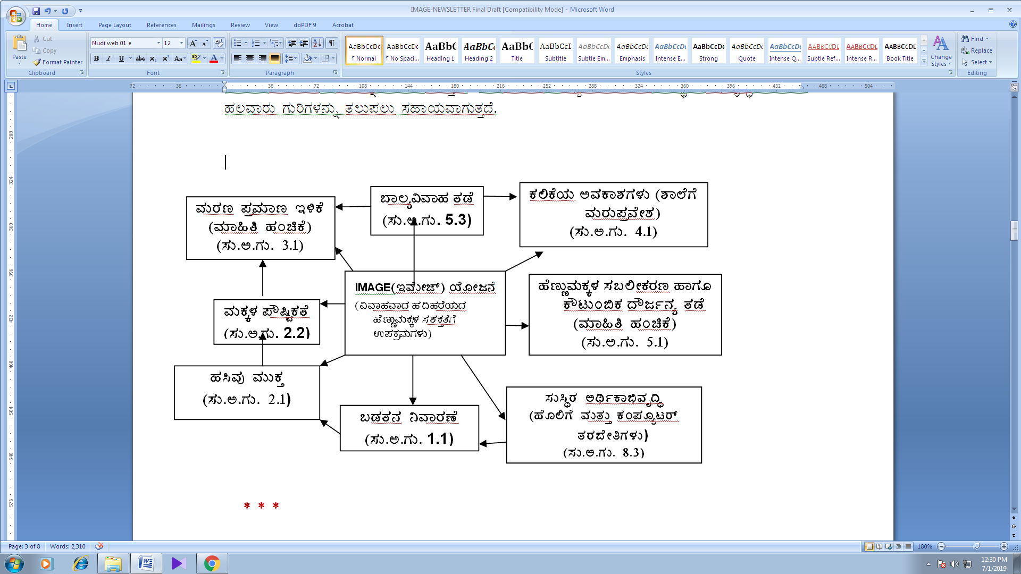
Inputs given on CR policies and laws
State level consultation held on 28th & 29th Dec 2018, at Vikasa Soudha, IMAGE collaborated with KSCPCR, CIF 1098, THP and Govt departments
Consultation with Govt to address EMG issues and demanded for a committee to review the policy, Act and programmes pertaining to PCMA (Amendment) Act , POCSO, D.V Act, JJ Act, ITPA, RTE etc. 22nd Sept. 2018
EMG and Child Marriage issues raised in the SDG Sub Group in the SDG State Committee
EM as an issue for school dropout brought to the notice of Education Dept, DWCD and Social Welfare

Slide 76
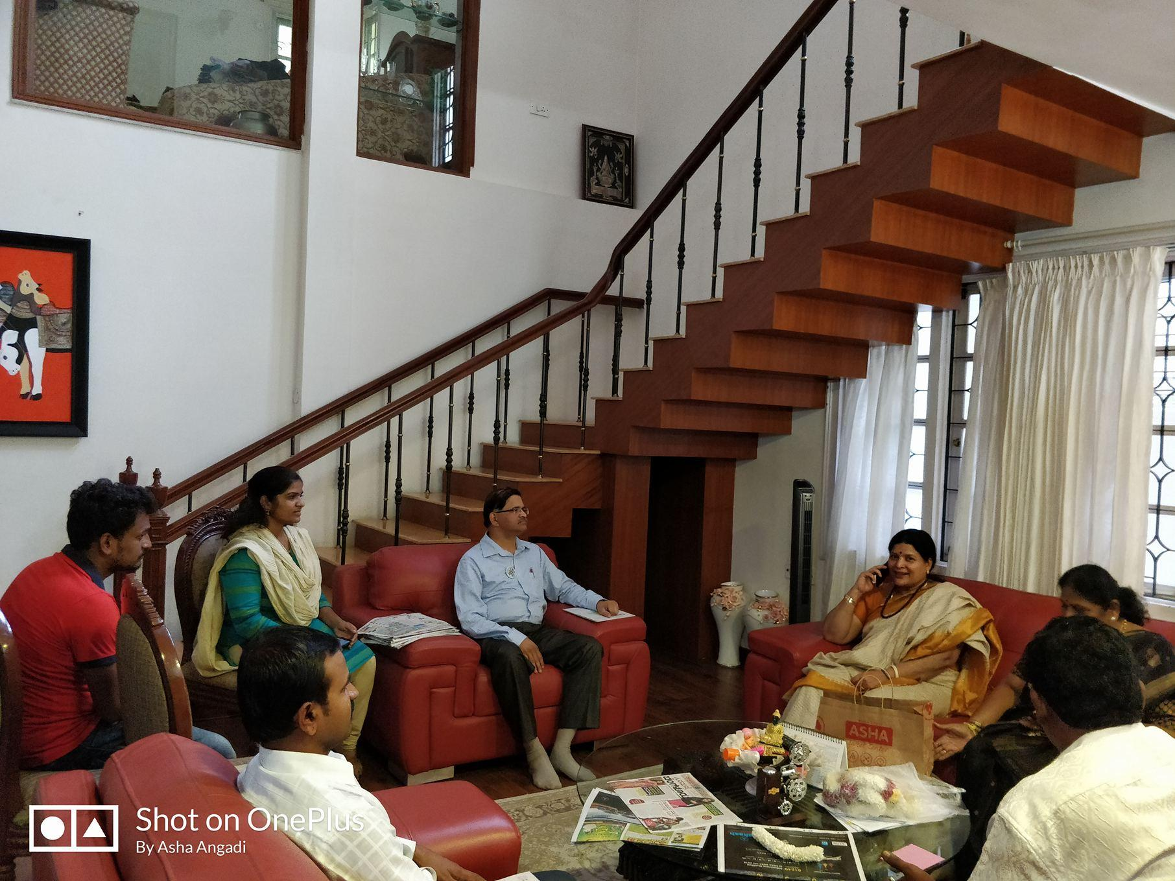
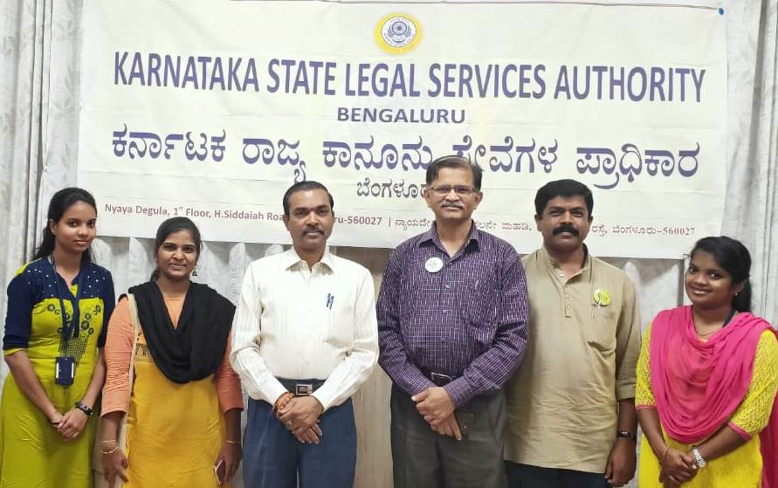

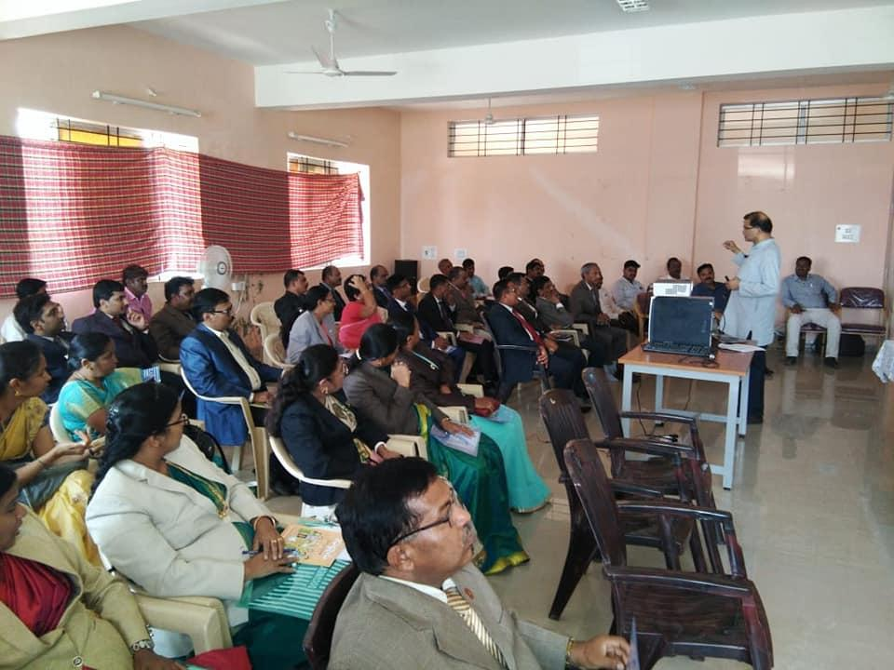
Networking and collaboration
1. RAPE Free India Campaign - BBA
and FAVOURD - K. Raised marital rape issues.
2. Collaboration with KLSA, workshop
conducted to District Judges and Public Prosecutors on Child marriage issues, at Haveri, Tumakuru, Bengaluru, Bidar and Kalburgi
3. Training to CWC Karnataka members on implementation of the Act from Child Protection with special reference to PCMA and POCSO.
4. EMGs issues included in the demands list presented to the political parties to be included in their manifestos (2018, 2019)

Slide 77
Progress in Cross Cutting Issues
CCIs | Progress made | Plan for next six month
Child Participation | In Child Rights Parliament majority participants are girls
Mainstreaming gender
Inclusion of CWD
Alternative care

Slide 78
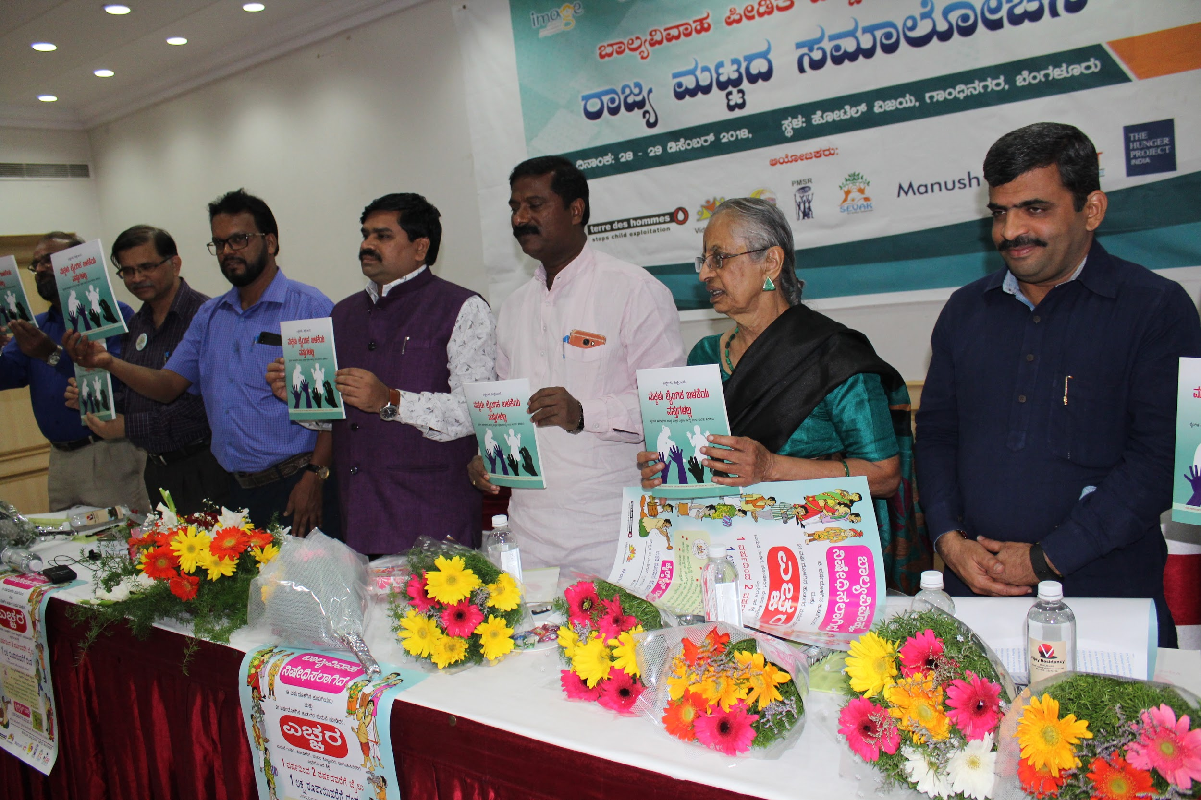
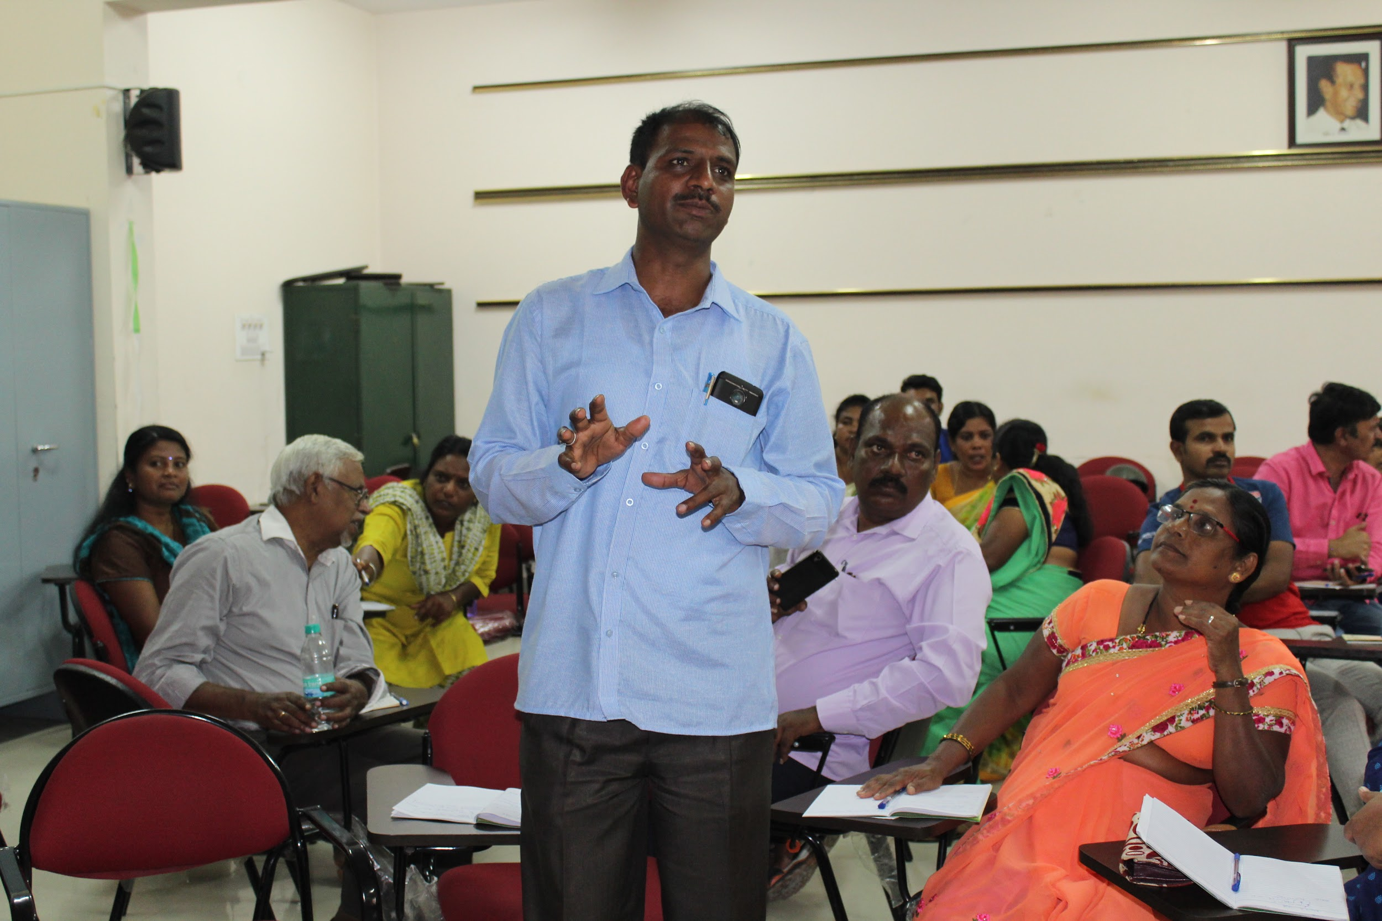
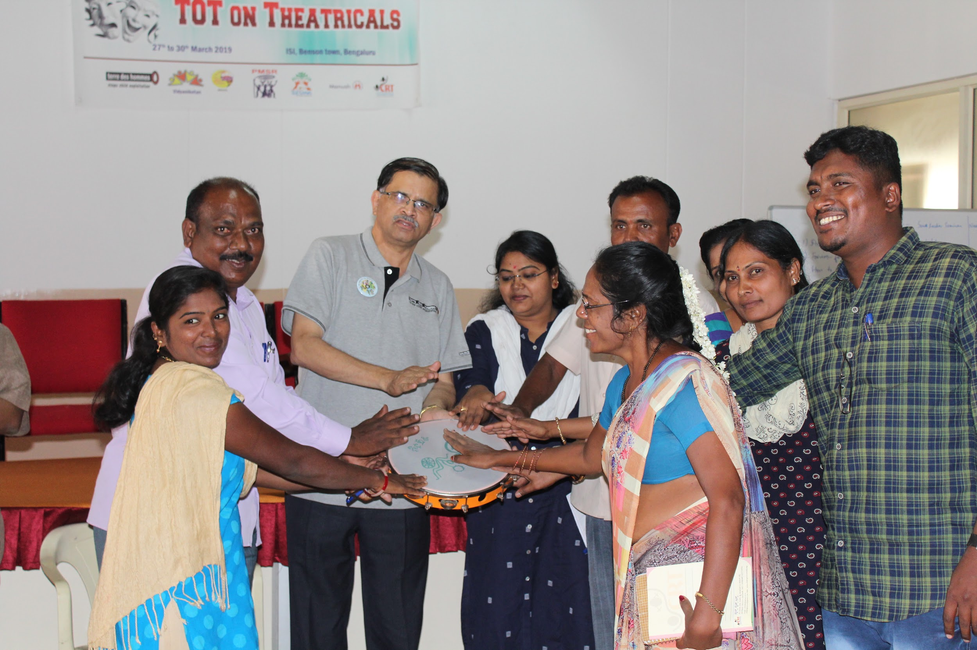
3 innovatives experimented in the programme (1.6 years)
Involving other NGOs and advocacy groups in the EMG discussion with the Govt. - CLPR, ChildLine, KSCPCR
Seminar on EMGs organised in the NIMHANS Golden Jubilee Conference, Jan 2019
Street play scripts developed by the team members in the workshop used in the Kalajathas
Observed Nov. 1st as Anti Child Marriage Day
Calendar on Child Marriage and EMG issues as an IEC widely accepted
Wall magazine to report on the developments in programmes and project

Slide 79
Outcomes in the programme (1.6 years)
Committee to study the situation of EMGs and recommend to the Government through a Government order (June 2019)
Prajavani writes an editorial on the plight of EMGs and calls for action from the Govt and the communities and EMG issue highlighted in the national news channel (CNN Network 18) (June 2019)
Improved case stories from the field by the team members of IMAGE partners
IEC material effectively used by the teams in reaching out to the communities, adolescent girls and Govt officials
EMGs boldly discussing with the media and Govt officials about the situation and demanding action*
Widened network among KLSA and NGOs in districts

Slide 80
3 Challenges faced during implementation (1.6 years)
Lack of Govt department cooperation and collaboration, never ending (continuous) follow ups (!), frequent transfer of officers
Trained team members leaving, losing expertise and experience - repeated sessions required
Delayed submission of case stories, data from the source for studies and analysis.

Slide 81
Budget utilisation
Year | Approved Budget | Amount received | Amount Utilised | Balance Amount | Reason for variation
2018 | 20,76,552 | 20,76,552 | 20,27,349 | 49,203
2019 Qtr 1 | 4,97,500 | 4,97,500 | 4,27,963 | 69,537
2019 Qtr 2 | 4,90,500 | 4,90,500 | 4,78,042 | 12,458
Total | 30,64,552 | 30,64,552 | 29,33,354 | 1,31,198

Slide 82
TdH-NL

Slide 83
3 innovative ideas experimented in the programme (1.6 years)
Co-implementation strategy in IMAGE partnership/consortium
Resource mobilisation from other international donor as part of consortium
Emotional support and motivation to EMGs through life skill trainings

Slide 84
3 Challenges faced during implementation (1.6 years)
Withdrawal of consortium partner
Support to partners for productive execution of project activities in accordance with baseline data survey findings and budget
Developing reporting skills and capturing achievements (activity reports, case studies, best practice etc )

Slide 85
Budget utilisation
Year | Approved Budget | Amount received | Amount Utilised | Reason for variation
2018 | 2,434,000 | 2,434,000 | 2,387,166
2019 Qtr 1 | 709,200 | 709,200 | 436,787 | Project Director Salary not utilised
2019 Qtr 2 | 715,450 | 715,413 | 695,603 | Project Director Salary not utilised
Total | 3,858,650 | 3,858,613 | 3,519,556

